Slide 1
Parish Share and how will you be able to afford it?
Diocese of Canterbury
Autumn 2024

Slide 2
Subjects covered in this presentation
  Increasing generosity and giving
  Diocesan finances
  Parish share
  Resources links

Slide 3
Some verses from the Bible about Generosity
Everything comes from you, and of your own have we given you.
(1 Chronicles 29:14)
Freely you have received; freely give. (Matthew 10:8)
God loves a cheerful giver. (2 Corinthians 9:7)

Slide 4
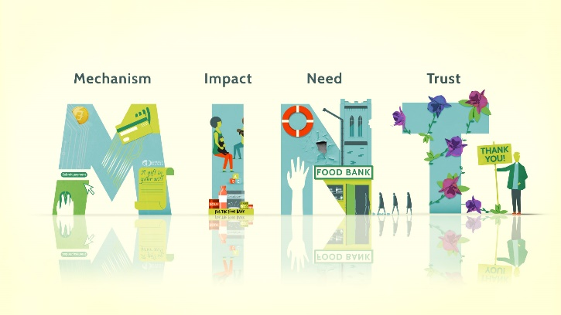
Increasing Generosity - MINT
Mechanisms – Having these in place so that people can give as much as they wish to easily
Impact – Communicating to people how their giving enables the mission and ministry of their church and how it enriches their local community
Need – Communicating the need your church has for money
Trust – Building trust with congregation and community members

Slide 5
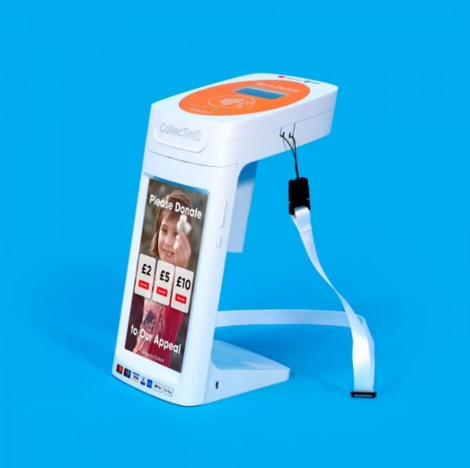
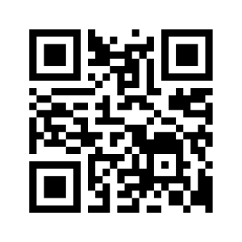
Mechanisms
Contactless Giving – Self-service devices such as CollecTin More and Payaz . New GWD devices such as the GWD Express work offline and can be rented
Online Giving – Add a “Donate Here” button to your website and link it via a QR code – the cheapest way to facilitate online giving is via PGS (1.5%) or Give a Little and Sum-Up (1.95%)

Slide 6

Parish Giving Scheme (PGS)
Enables regular giving at no transaction cost
Direct Debit collection from donors
Several ways for people to sign up: online, paper form, telephone – flexible and accessible
Option to increase gift annually in line with inflation
Gift-Aid processed by the scheme including on one-off donations

Slide 7
Increasing Generosity – EASY WINS
Contactless devices
QR codes
Online donations
Parish giving scheme (PGS)
Gift aid

Slide 8

Legacies
Communicate to people how leaving a gift to a church in their will can help the church’s good work continue after they die
Communicate how your church might use a legacy
Importance of having a legacy policy
For more information see here: https://parishresources.org.uk/giving/legacies/
Consider joining Christian Aid’s Faith Will Campaign to help promote the importance of writing a will and leaving a gift to both Christian Aid and your church.
https://www.christianaid.org.uk/appeals/key-appeals/faith-will

Slide 9
Generating income
Depending on your resources you can generate additional income:
Renting out church halls and other buildings
Renting out empty parking spaces with JustPark https://www.canterburydiocese.org/parishsupport/generosity-giving/just-park
Fundraising events such as Ride and Stride
Run a Gift Day
Other ventures such as a Church Café, Magazine (advertisement revenue)
Take advice on how best to invest your church’s resources

Slide 10
Fundraising Leaflets generousgiving@diocant.org
Please contact the Generous Giving Team for our new Canva templates to share MINT with congregation members and people in the wider community.
Communicate why your church is worth supporting, how people can contribute and build trusting relationships.

Slide 11

THANK YOU!
We would like to thank all of you, your PCCs and congregations for all your hard work supporting our Christian community.
It is not well known but in comparison with others, the Diocese of Canterbury is actually a very poor diocese.

Slide 12
2023 Financial results and why do we need Parish Share
Parish Share is main source of income for our diocesan community to support activities of the whole diocese. The chart below shows all our sources of income in 2023 (including restricted).

Slide 13
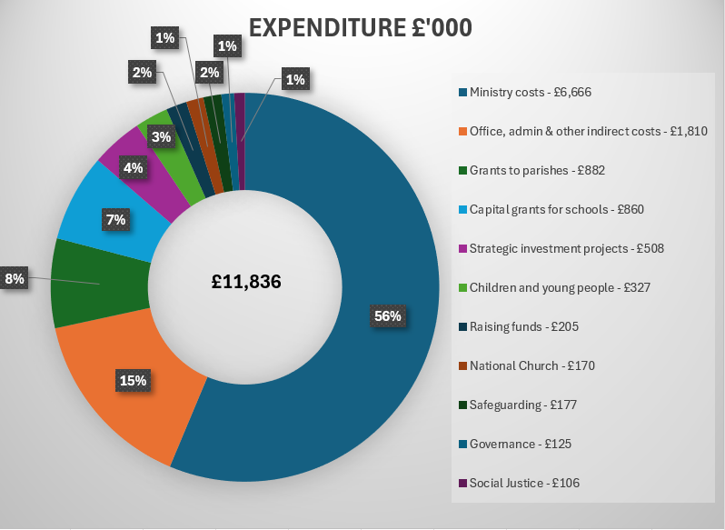
2023 expenditure
The biggest spend are ministry costs and office, admin and other indirect costs (support services without safeguarding). The chart below shows all types of expenditure in 2023 (including restricted).

Slide 14
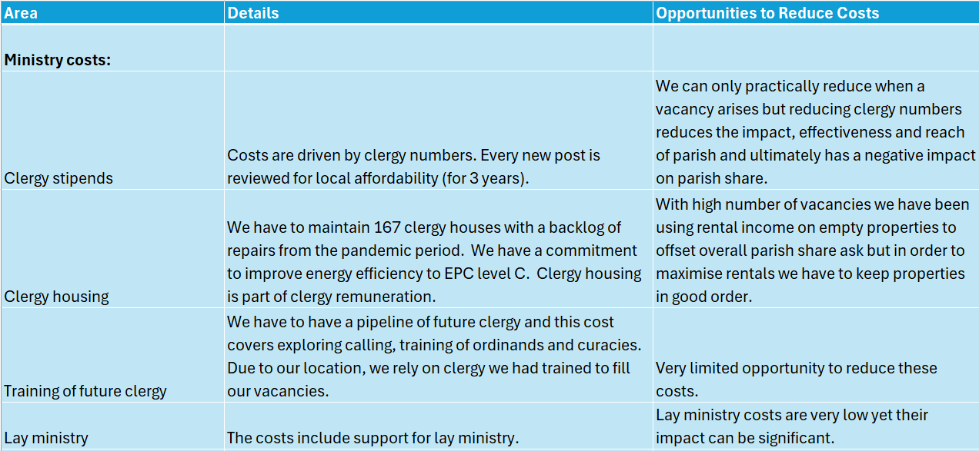
Further Details on Expenditure

Slide 15
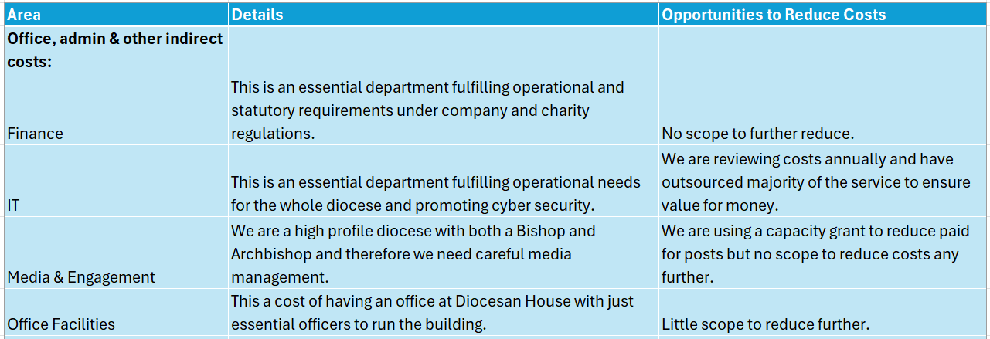
Further Details on Expenditure

Slide 16
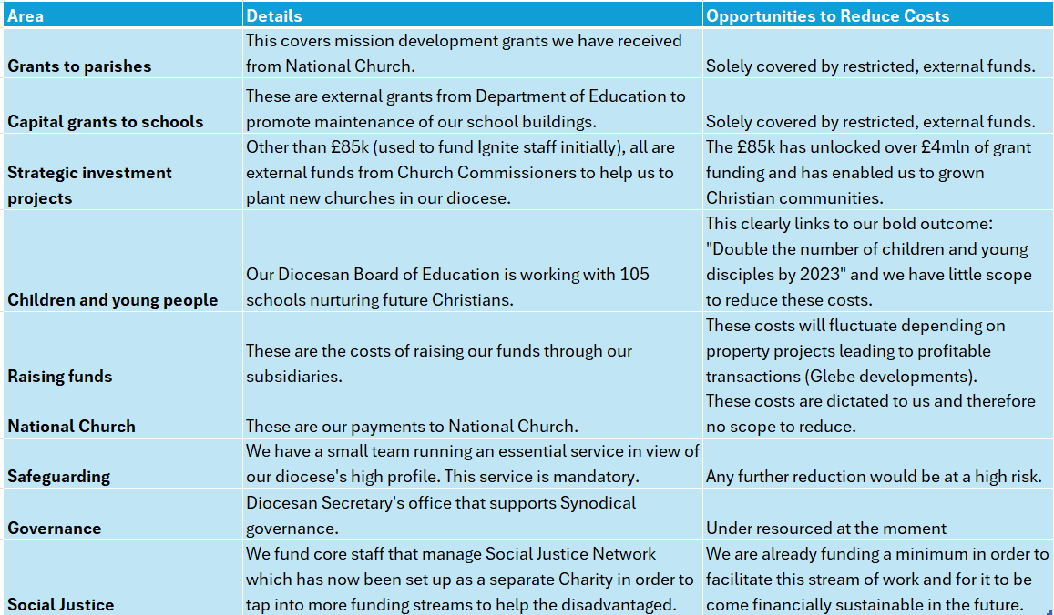
Further Details on Expenditure

Slide 17
How do our Support costs compare?
Not for profit sector
Admin expense ratio: 19% vs Range 15% to 25%
Other dioceses
Headcount in line with similar dioceses
More detailed study expected summer 2024
Parish Share collection: 90% vs Average 90%
Conclusion
Support costs are reasonable
A focus on efficiency and cost reduction has already enabled improvements and savings

Slide 18
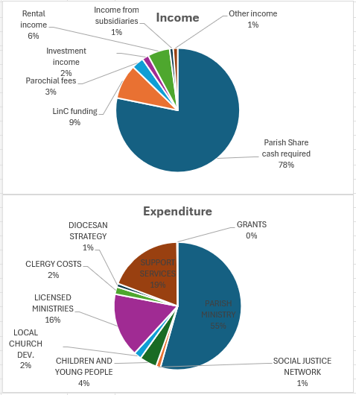
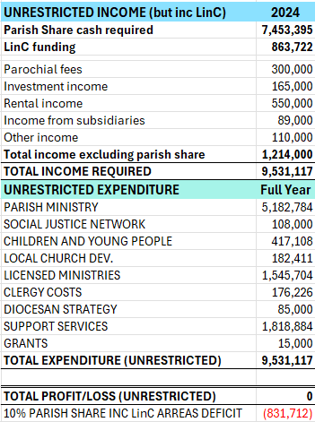
2024 Budget – Income & Expenditure (unrestricted)

Slide 19
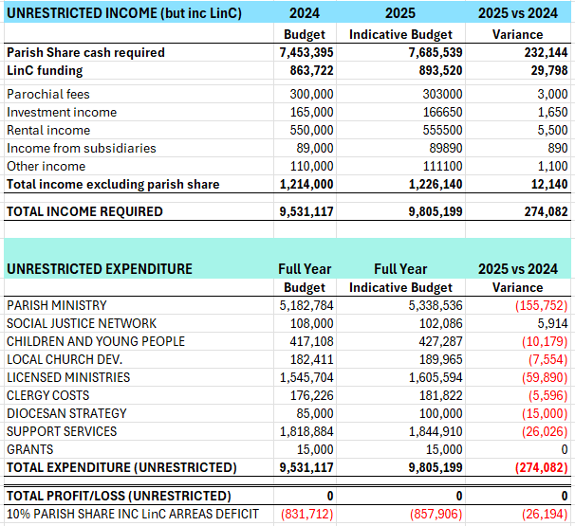
2025 Indicative Budget
BASIC ASSUMPTIONS
3% increase in salaries (9 months of the year only), 1% increases in other costs, 5% increases in council tax.
These numbers are subject to change whilst we update it with new information for the approval by the Synod in November 2024.
The increase from 2024 to 2025 is 3% but this does not mean your parish share will increase by 3%.
Please turn over to the next slide to find out how parish share is calculated.

Slide 20





Parish share calculation
The calculation is based on:
The overall amount to be raised
Average weekly attendance (AWA)
Deprivation factor
FTE of minister and their housing

Slide 21
Why do we need to pay parish share
The Diocese is a community of parishes - we are all members of the Diocesan community – and your parish share is like a membership fee used to pay our community’s shared costs.
Although the PCCs are all independent in terms of their charity status, the Diocese supports individual PCCs, for example when they need a bridging loan or advice.
Parish Share is an investment which enables ministry and mission to take place at a local level.

Slide 22
When do we need to pay parish share
Should be paid monthly or in the first 10 months of the year.
Payments for 2024 parish share will close on the 15th January to allow us to prepare our accounts.
The final parish share statement for 2024 will be sent in February 2025.
Arrears may be paid at any time during the year where possible.

Slide 23
Coming Up
Treasurers’ Coffee Mornings (Spring 2025)
Another mini contactless device rollout – try before you buy (March 2025)
Cornerstone - an online tool to help churches understand their giving culture and an in-person workshop to facilitate its use. We hope to be engaging with this from June onwards.
Treasurer Training (2025)

Slide 24
Church grants Database
Login can be accessed here: https://canterbury.churchgrants.co.uk
Or via the Canterbury Diocese website here: https://www.canterburydiocese.org/parishsupport/generosity-stewardship/grant-opportunities.php
Apply to generousgiving@diocant.org for your unique parish reference number

Slide 25
Helpful Resources and Contacts
Diocese of Canterbury Website
https://www.canterburydiocese.org/parishsupport/generosity-giving
Parish Giving Scheme
https://www.parishgiving.org.uk/home
Parish Buying (discounted purchasing on contactless and online giving options)
https://parishbuying.org.uk

Slide 26
Resources and Contacts Cont.
Church of England Generous Giving
https://www.churchofengland.org/resources/building-generous-church
JustPark
https://forms.office.com/e/YD9e9NqdK8
Parish Resources
https://parishresources.org.uk/giving

Slide 27
Resources and Contacts Cont.
Kent University MOOC (Massive Online Open Course) in Fundraising
https://www.kent.ac.uk/social-policy-sociology-social-research/news/5790/free-online-fundraising-course-from-the-centre-for-philanthropy
Ecclesiastical – Fundraising Hub
https://ecclesiastical.com/churchfundraising

Slide 28
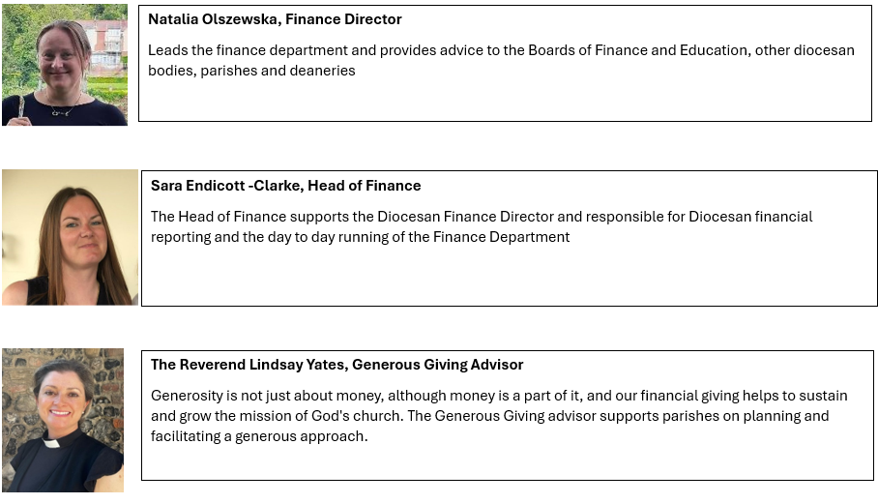
Meet the Finance Team finance@diocant.org; generousgiving@diocant.org

Slide 29
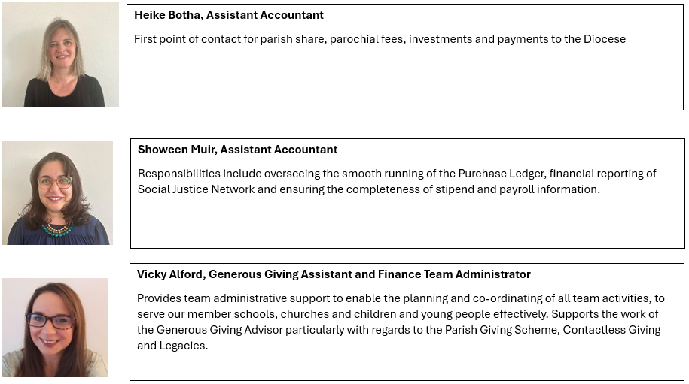
Meet the Finance Team finance@diocant.org; generousgiving@diocant.org

Slide 30
