Slide 1
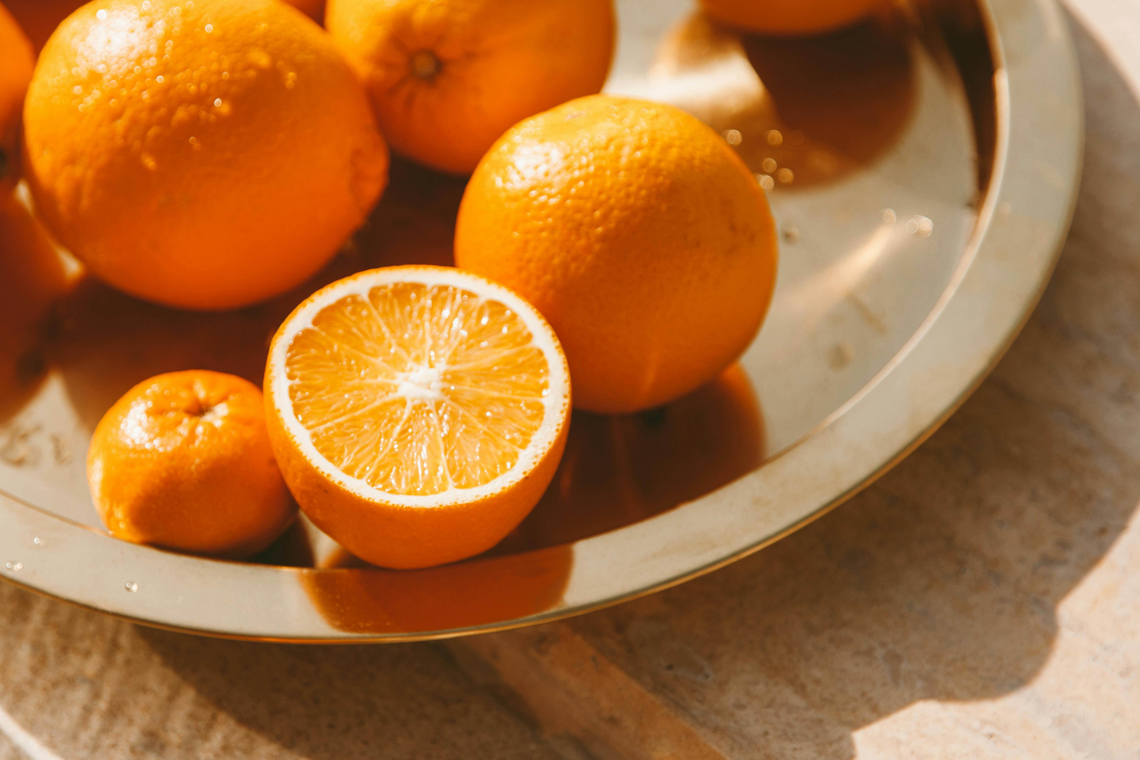
Vine, tree or bush?

Slide 2
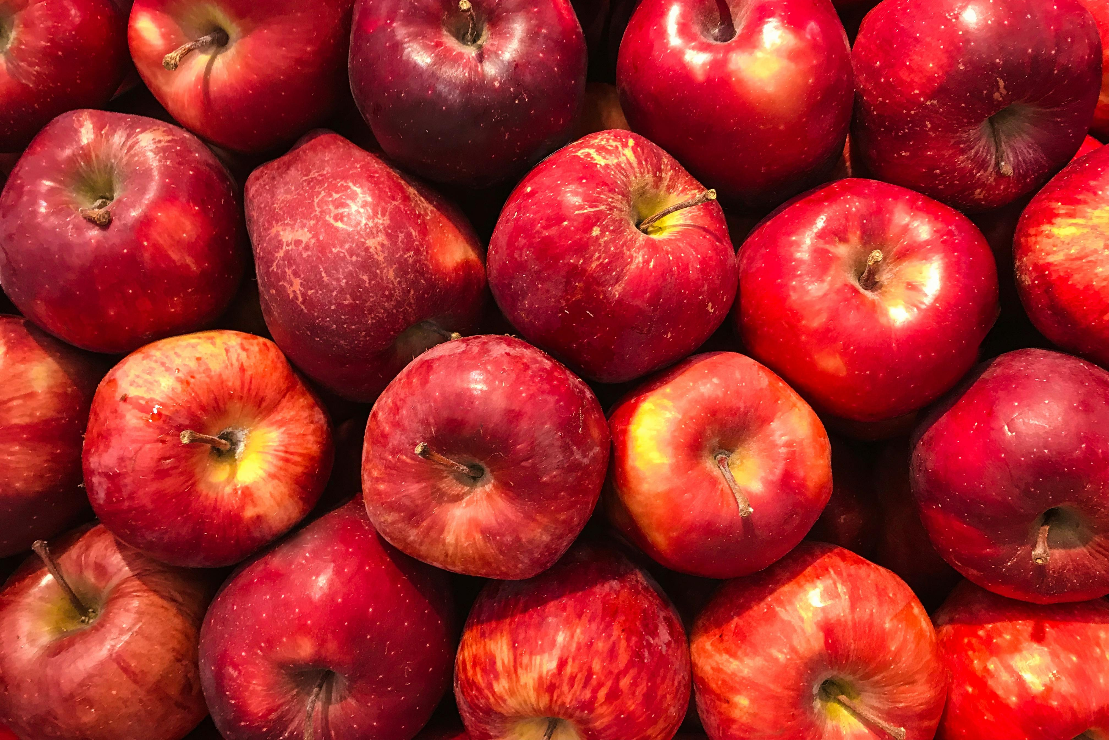
Vine,
tree
or
bush?

Slide 3
tree

Slide 4
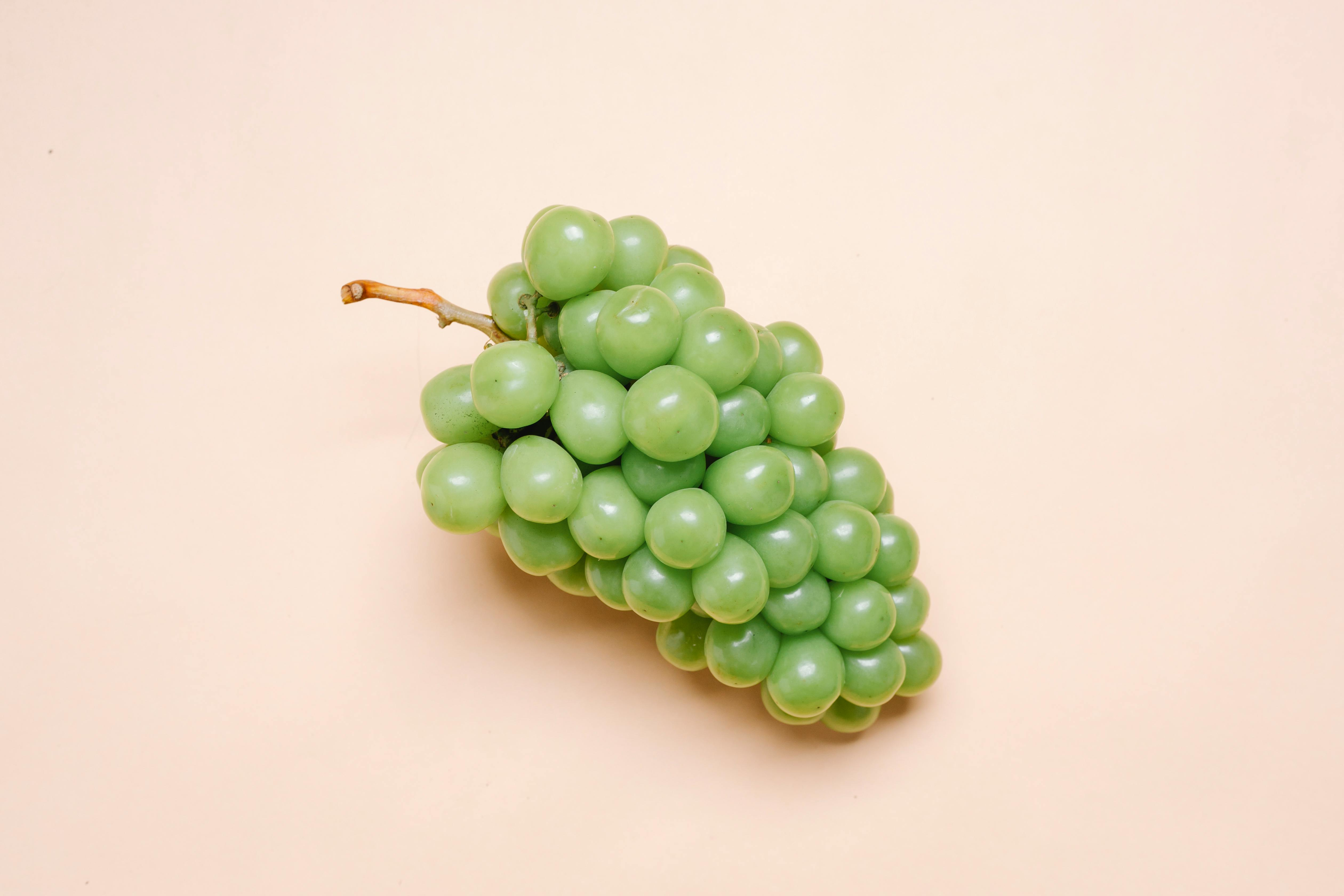
Vine,
tree
or
bush?

Slide 5
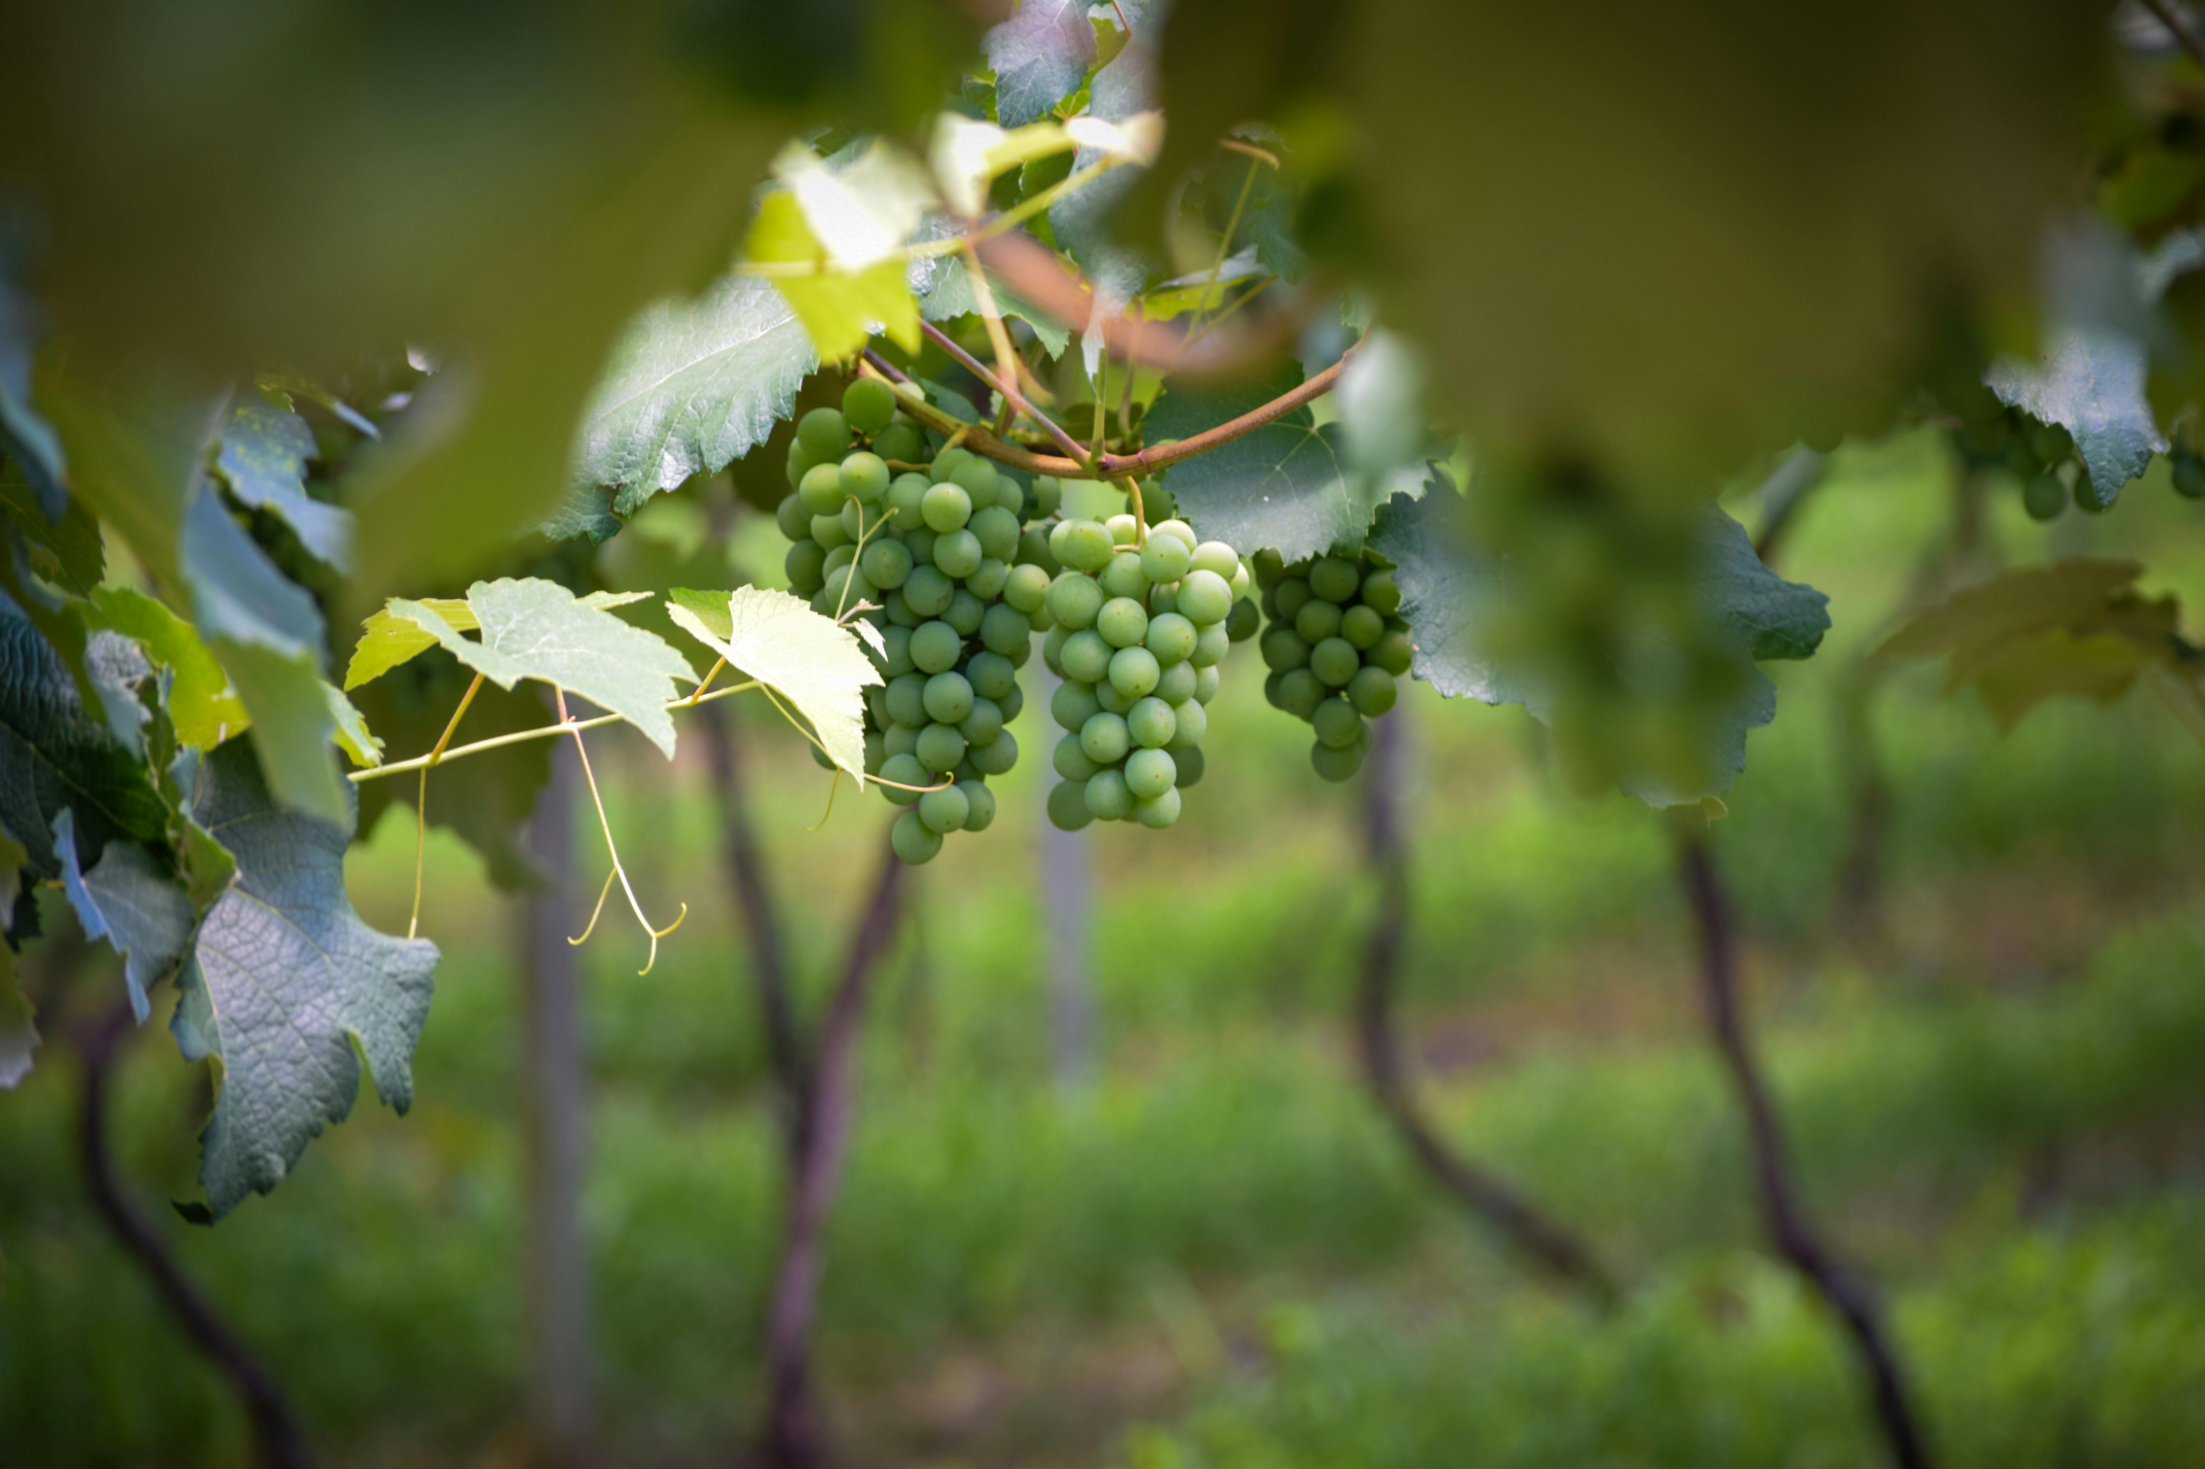
Vine

Slide 6

Vine,
tree
or
bush?

Slide 7
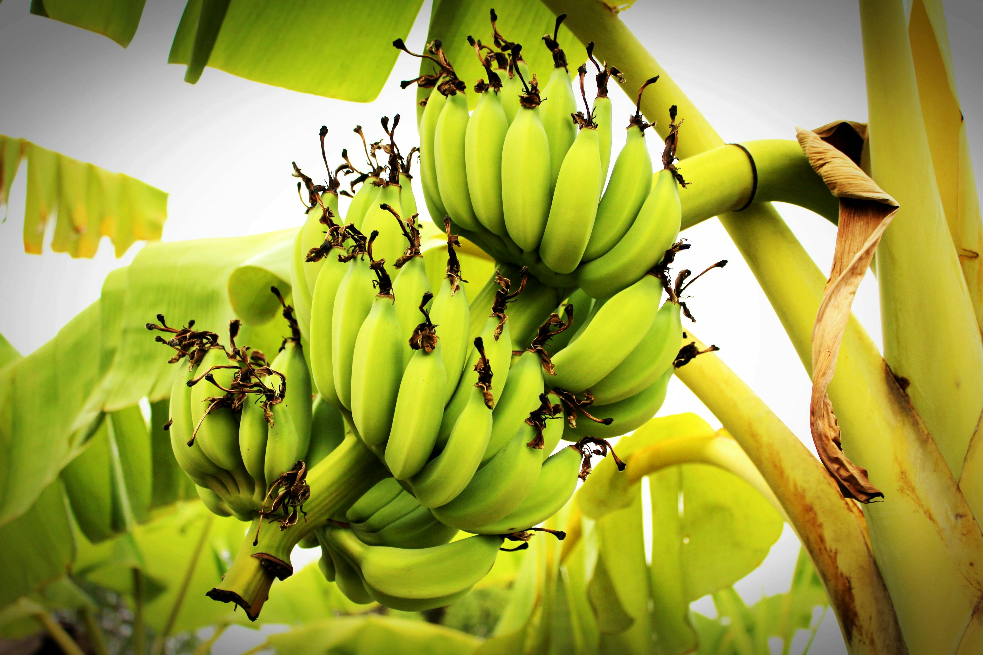
tree

Slide 8
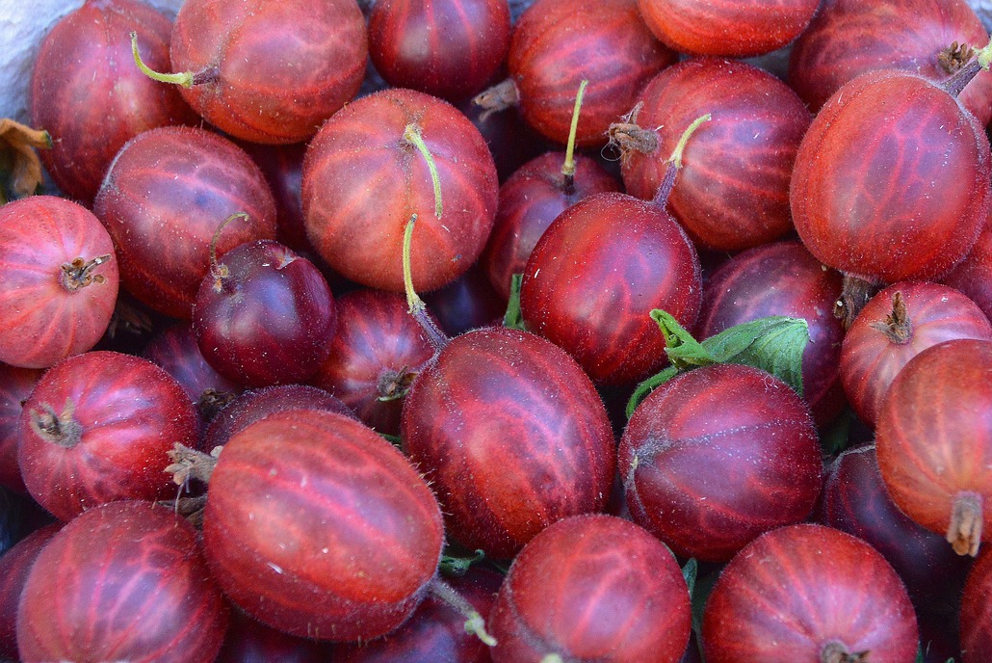
Vine,
tree
or
bush?

Slide 9
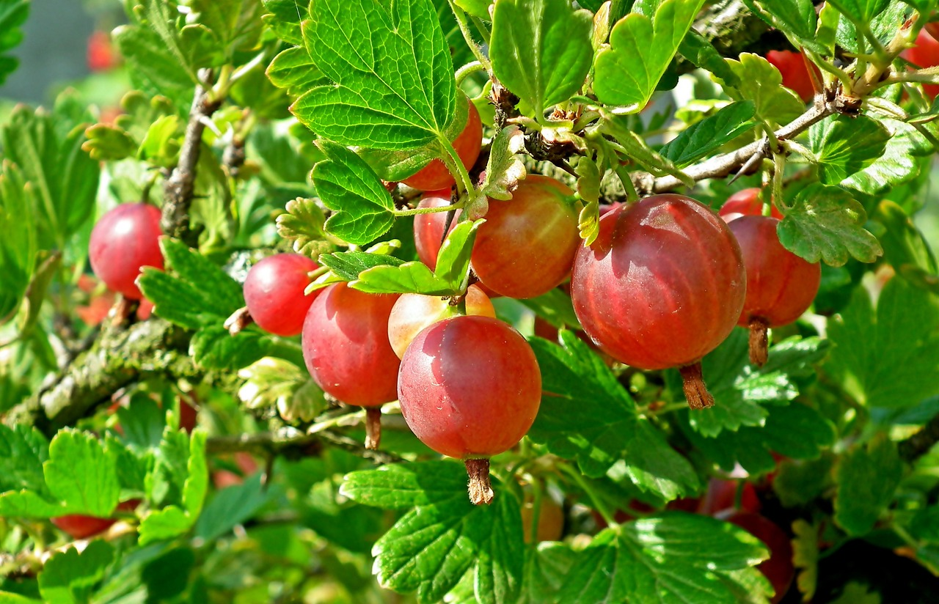
bush

Slide 10
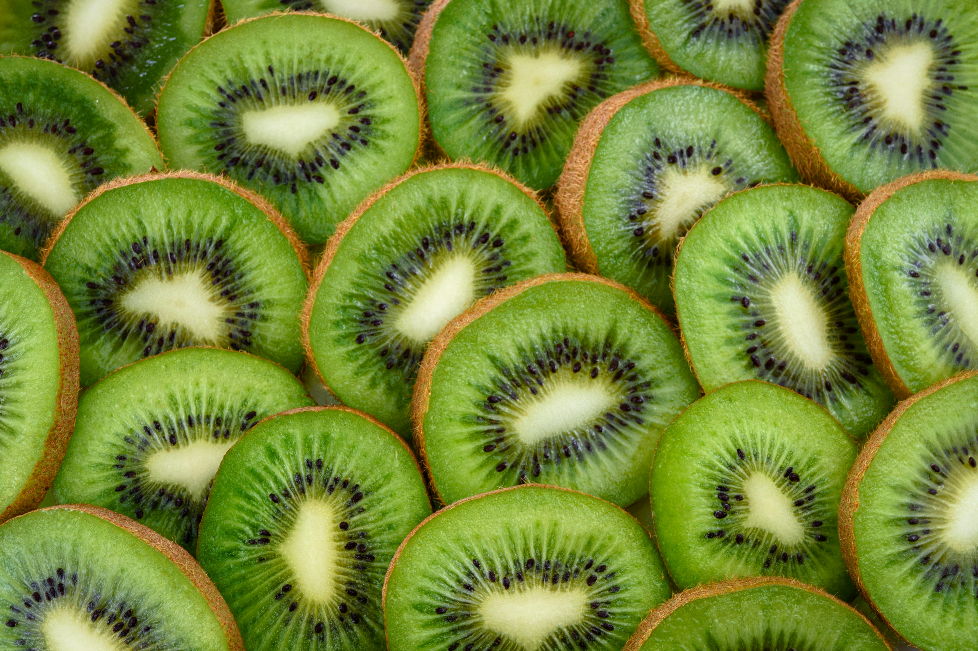
Vine,
tree
or
bush?

Slide 11
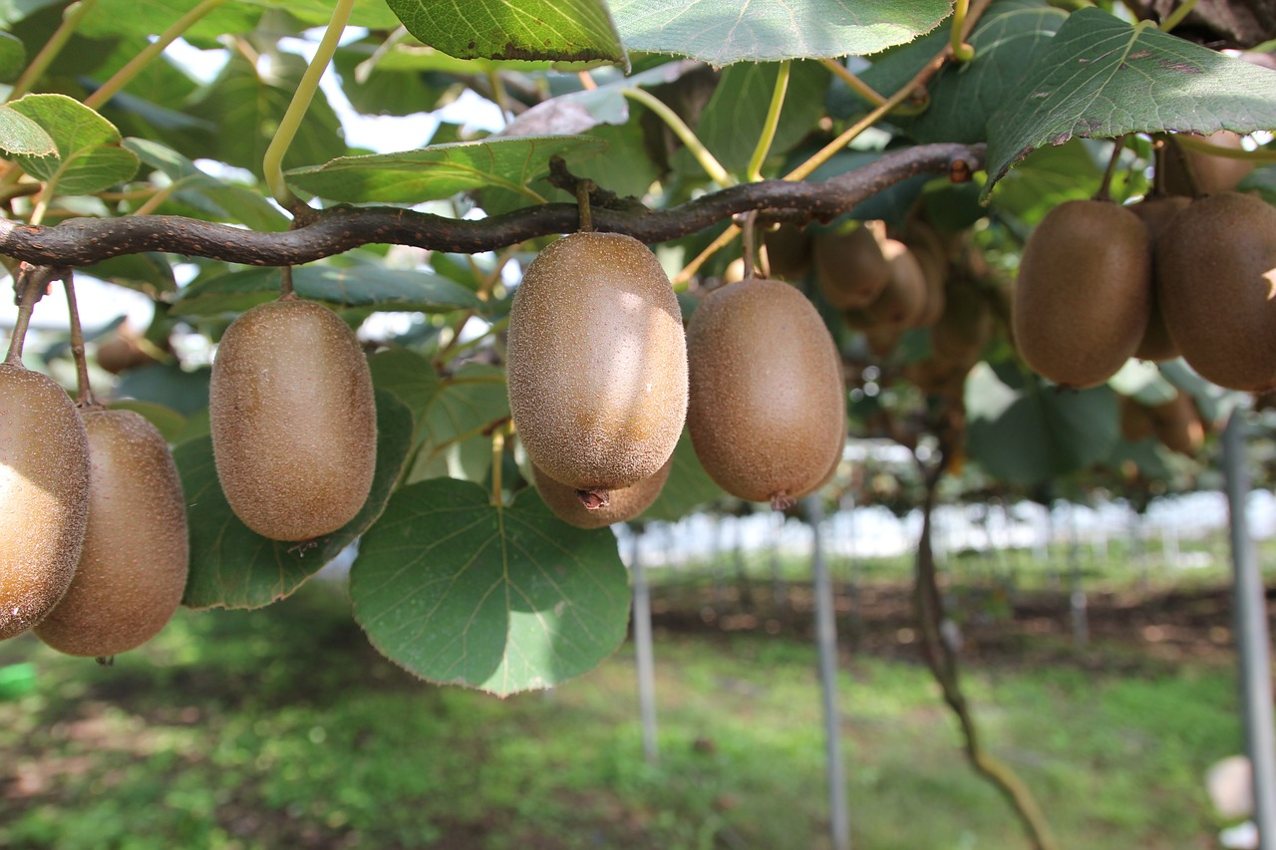
Vine

Slide 12
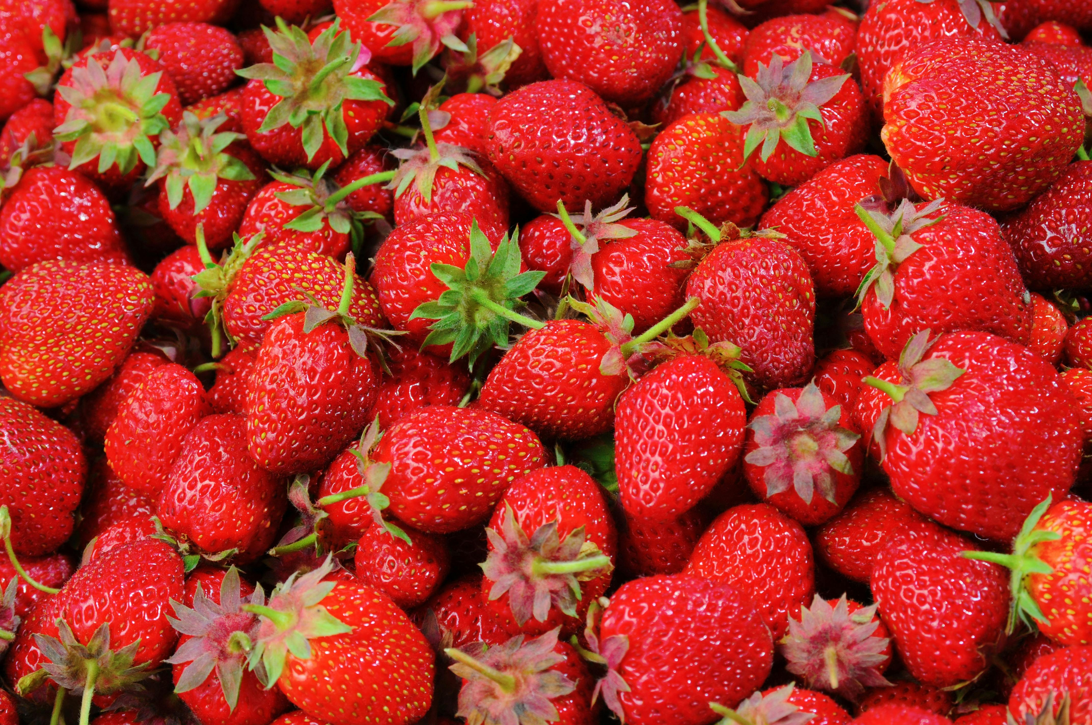
Vine,
tree
or
bush?

Slide 13
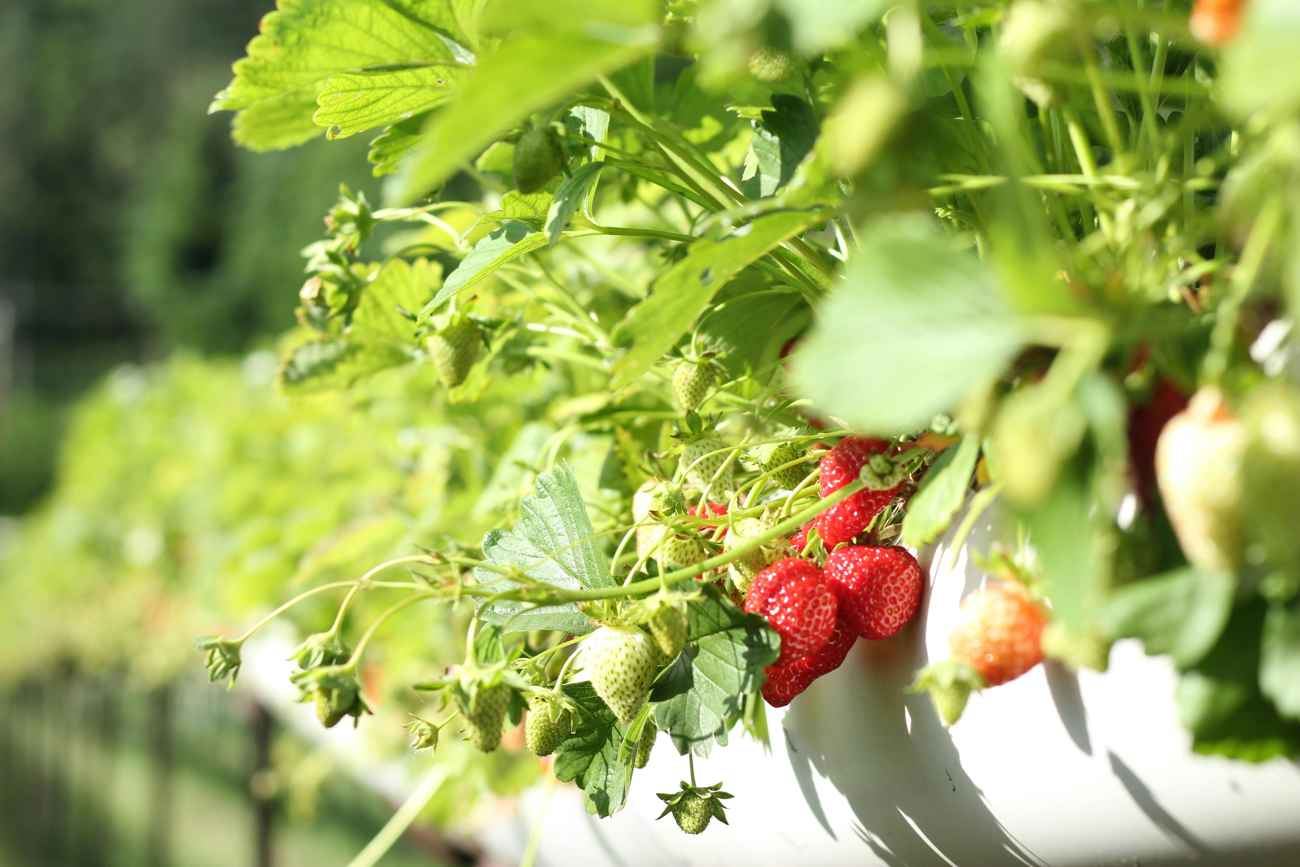
bush

Slide 14
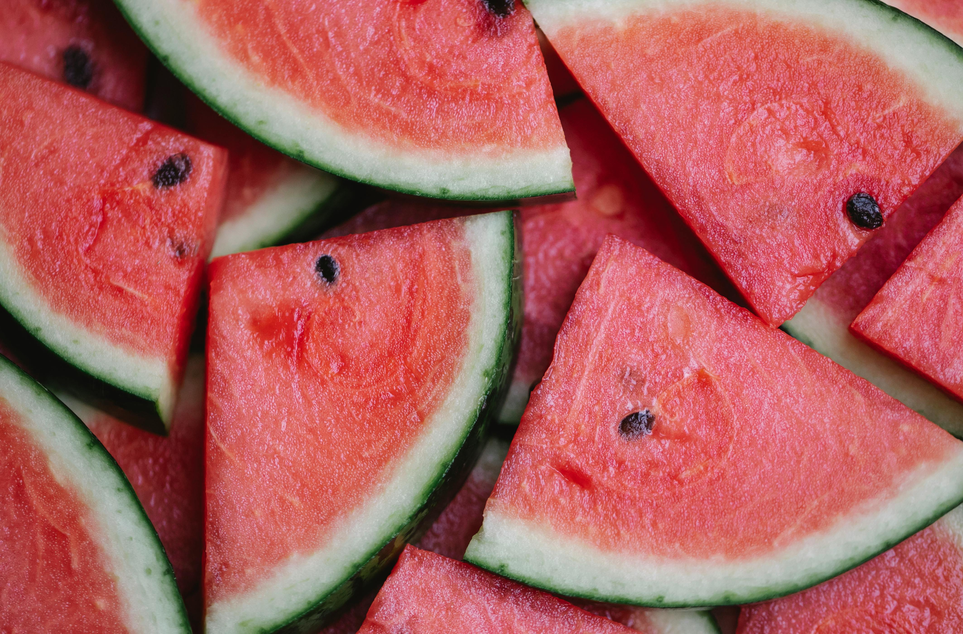
Vine,
tree
or
bush?

Slide 15
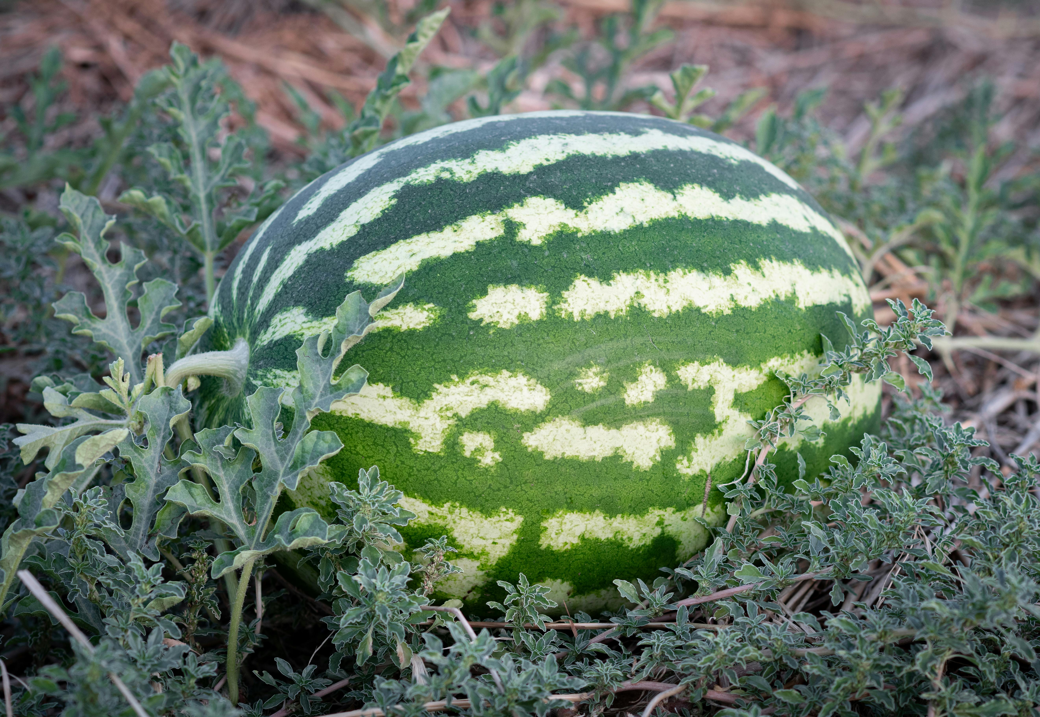
Vine

