Slide 1
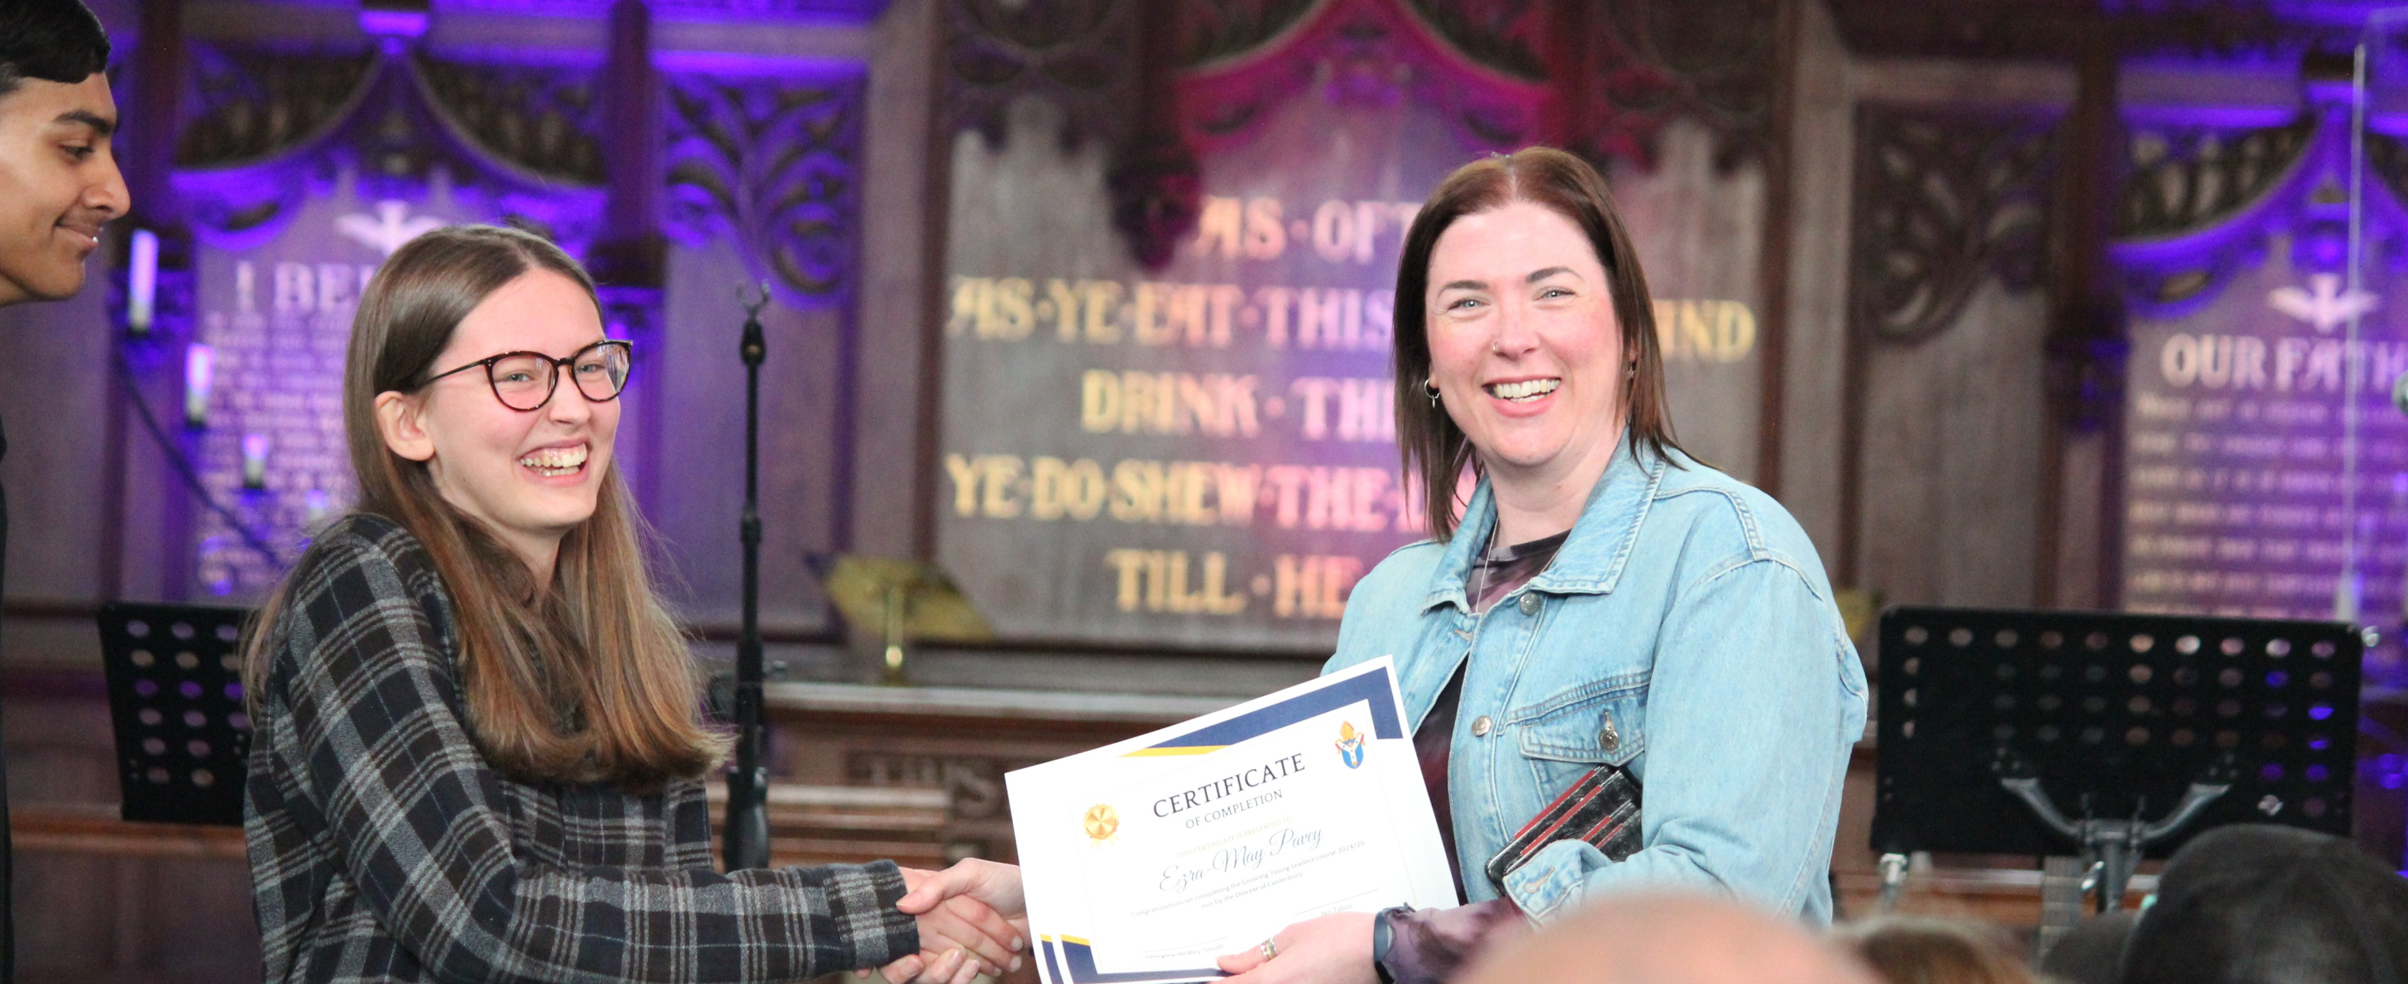

Growing Young Vocations Day
Saturday 28 March 2026

Slide 2
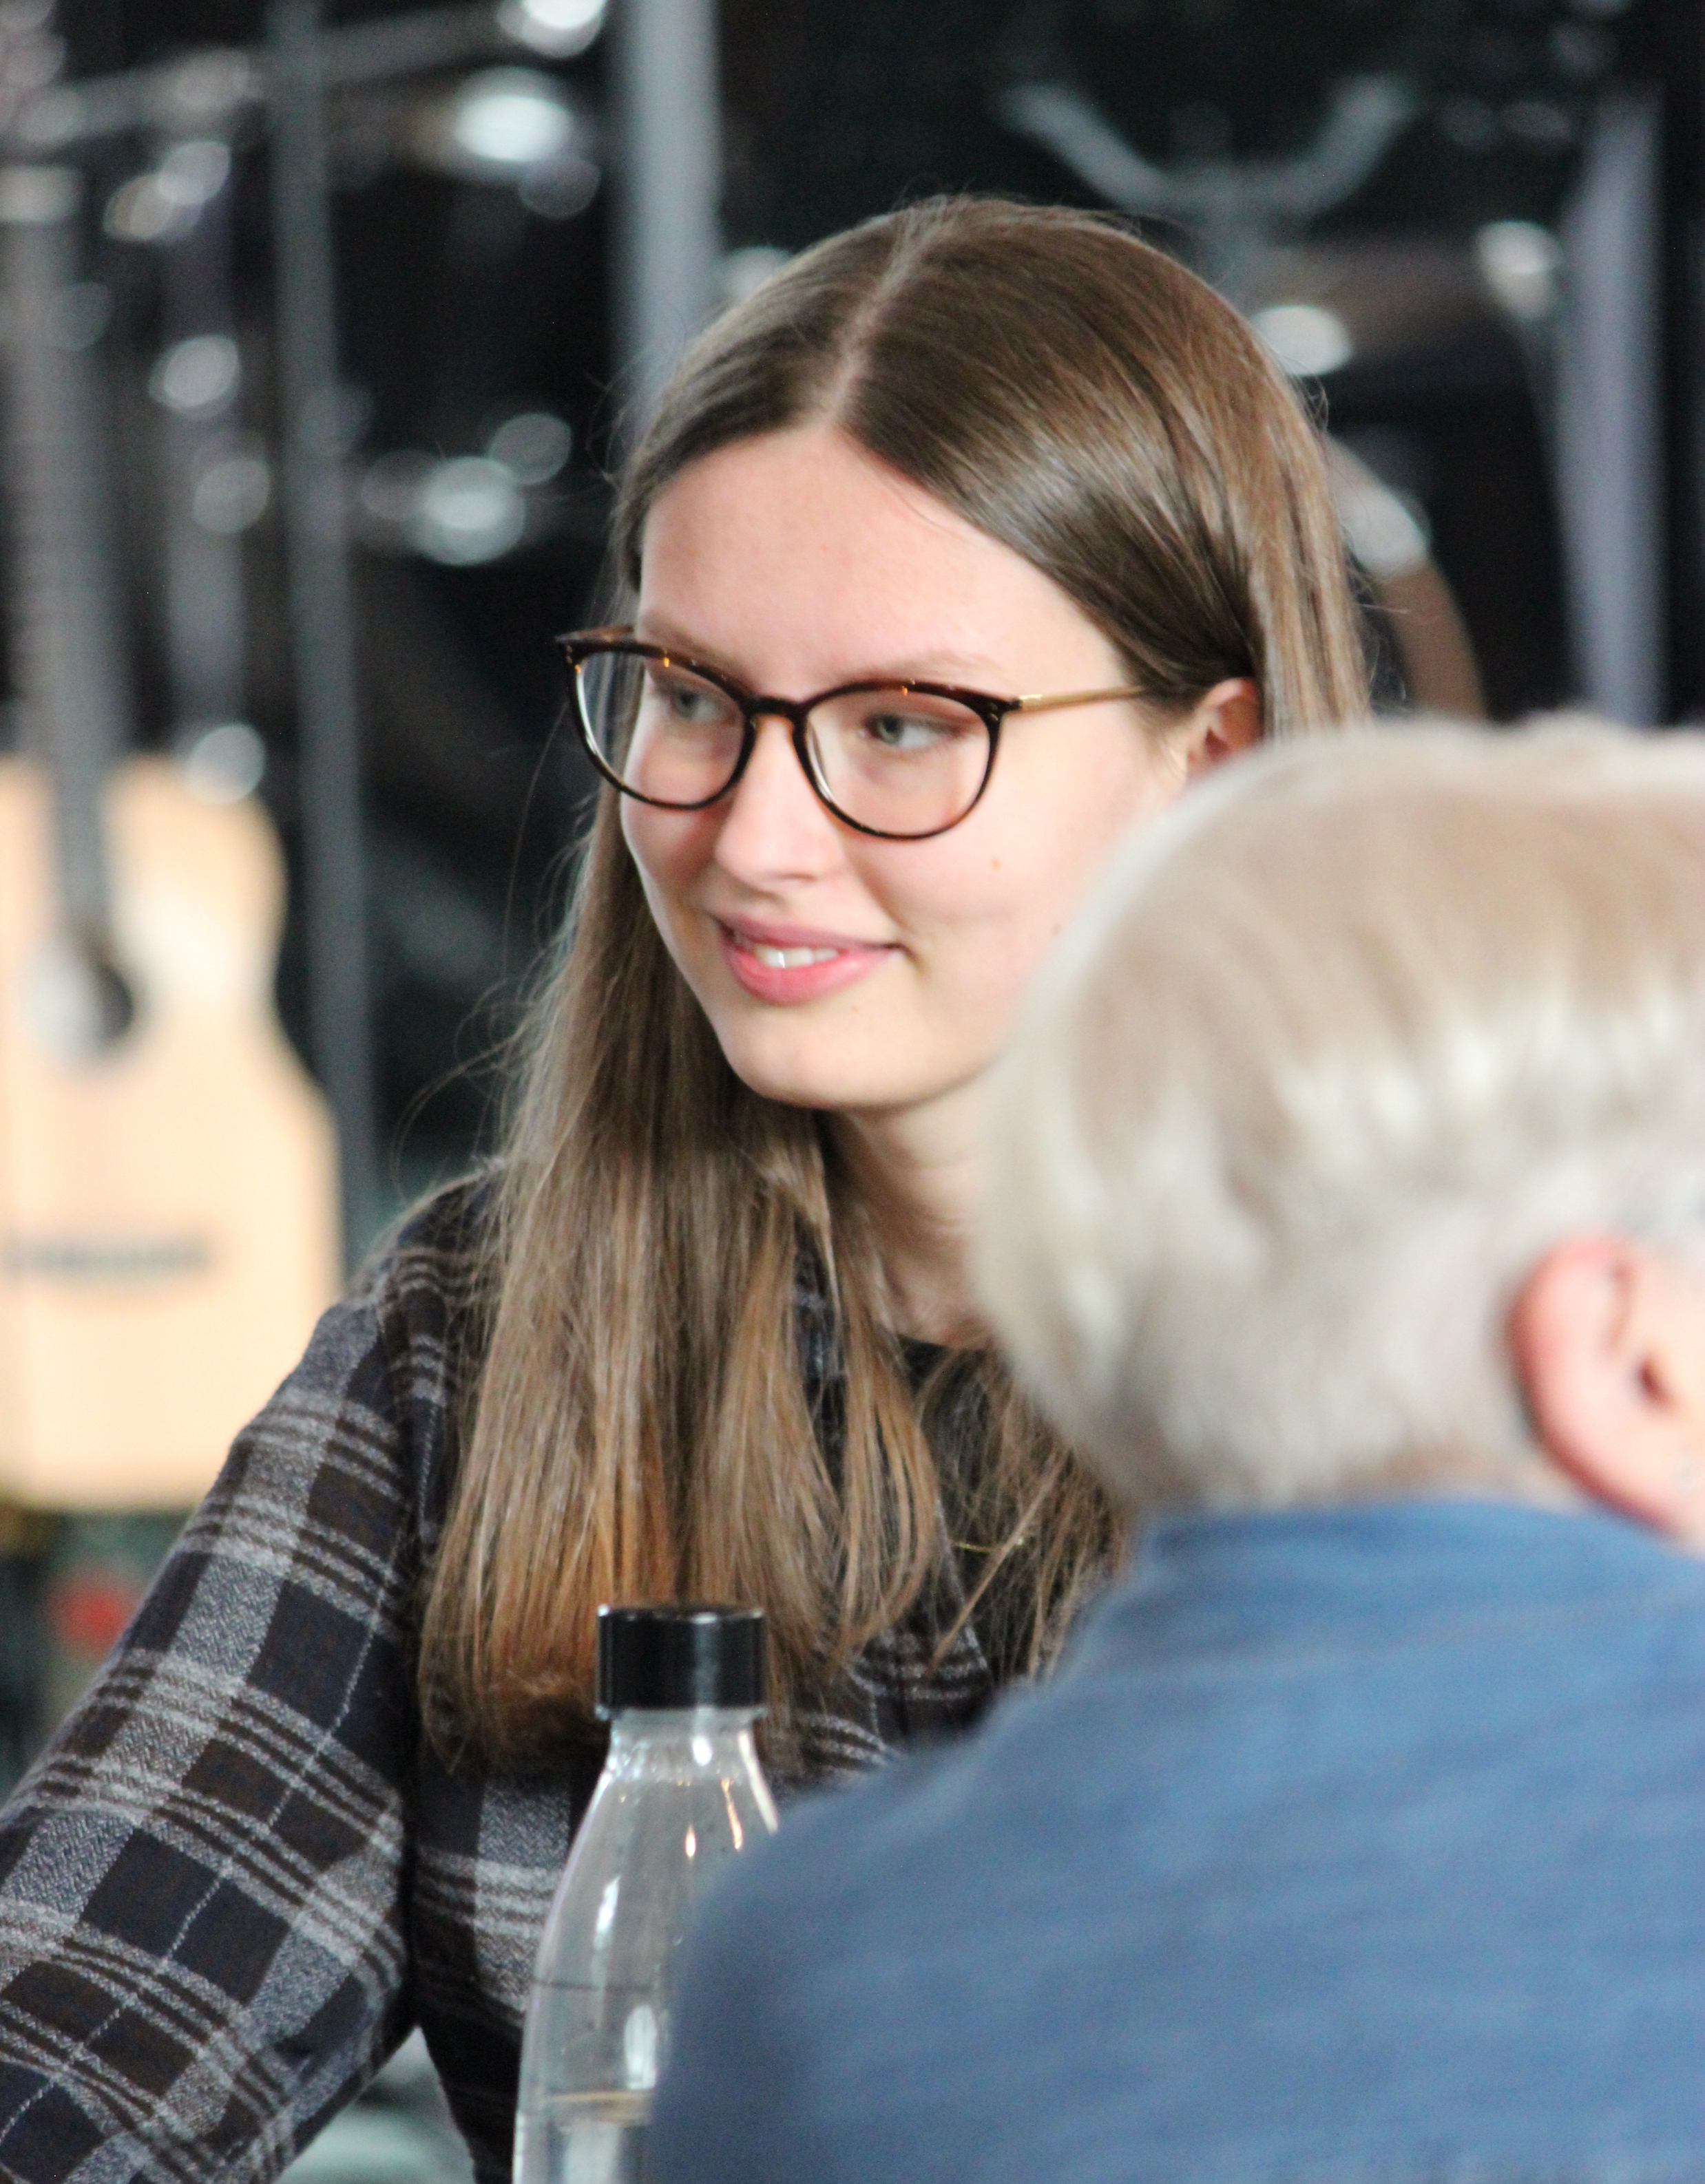
Event overview
A celebration of young leaders
Encouragement and the chance to explore your gifts
Equipping those who work with young people

Slide 3
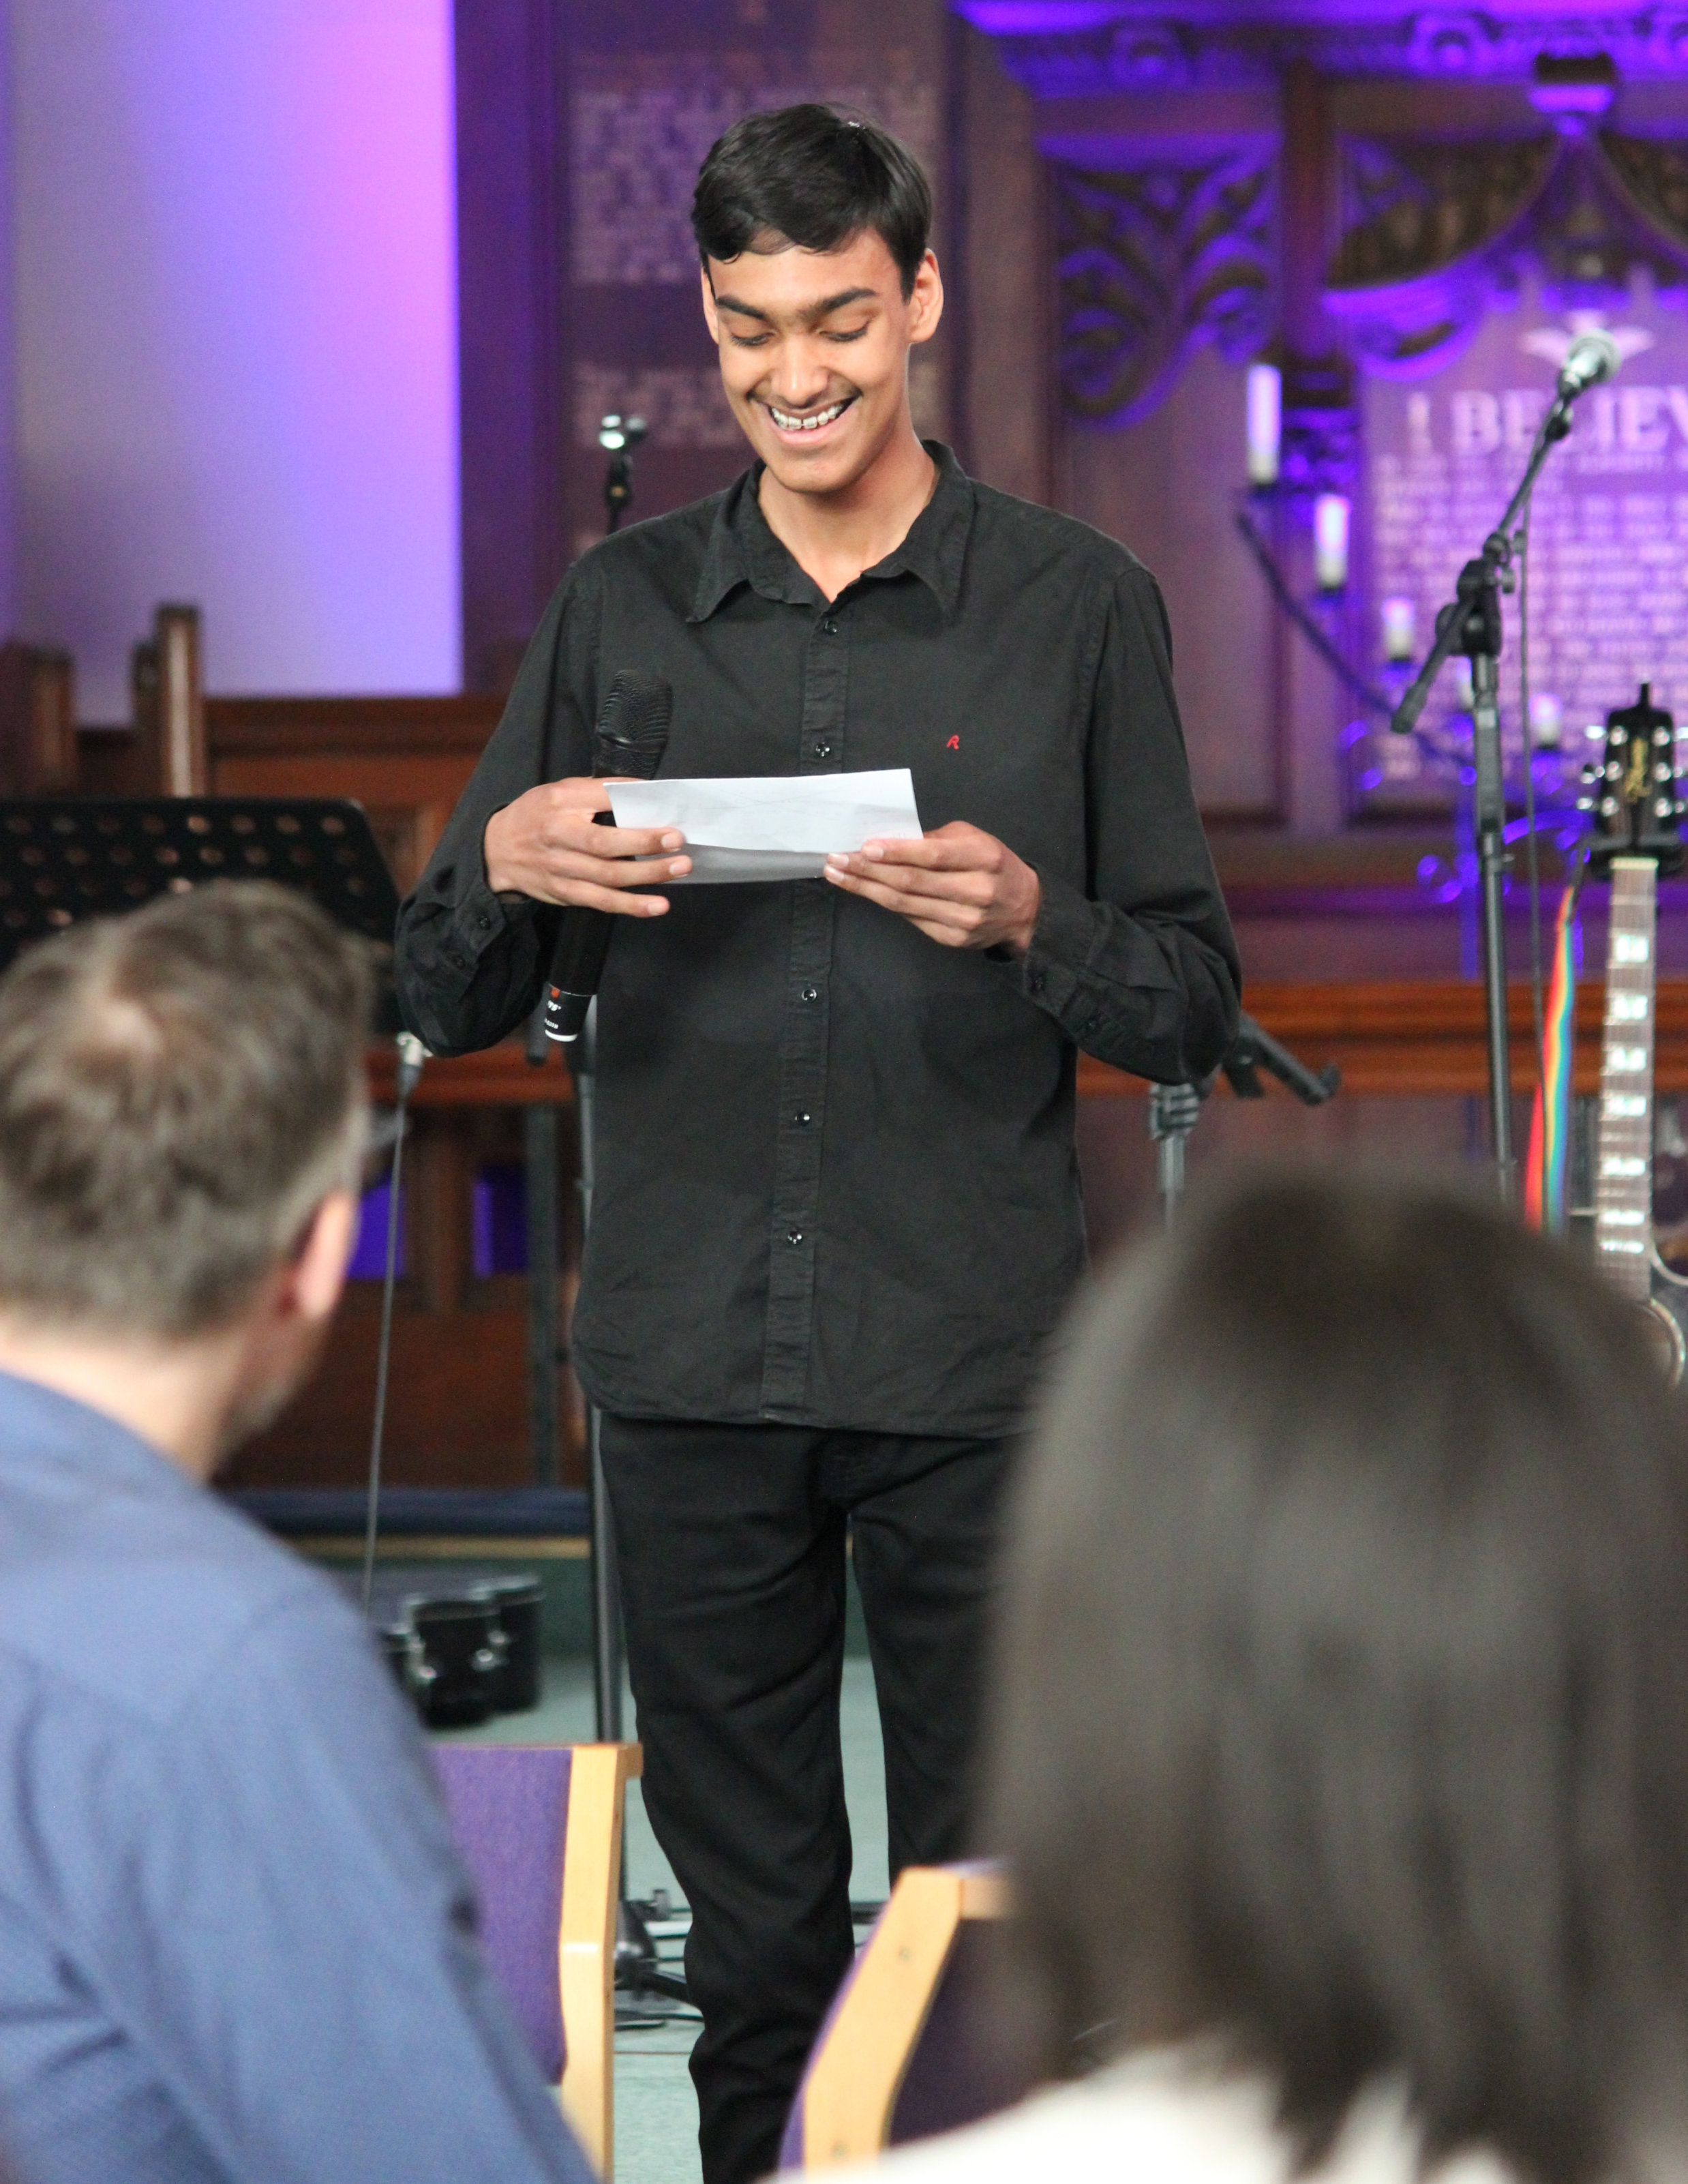
Who can attend?
Young people aged 14-25 (no previous experience in ministry required, just a hunger to find out more)
Youth ministers
Clergy
Church leaders

Slide 4
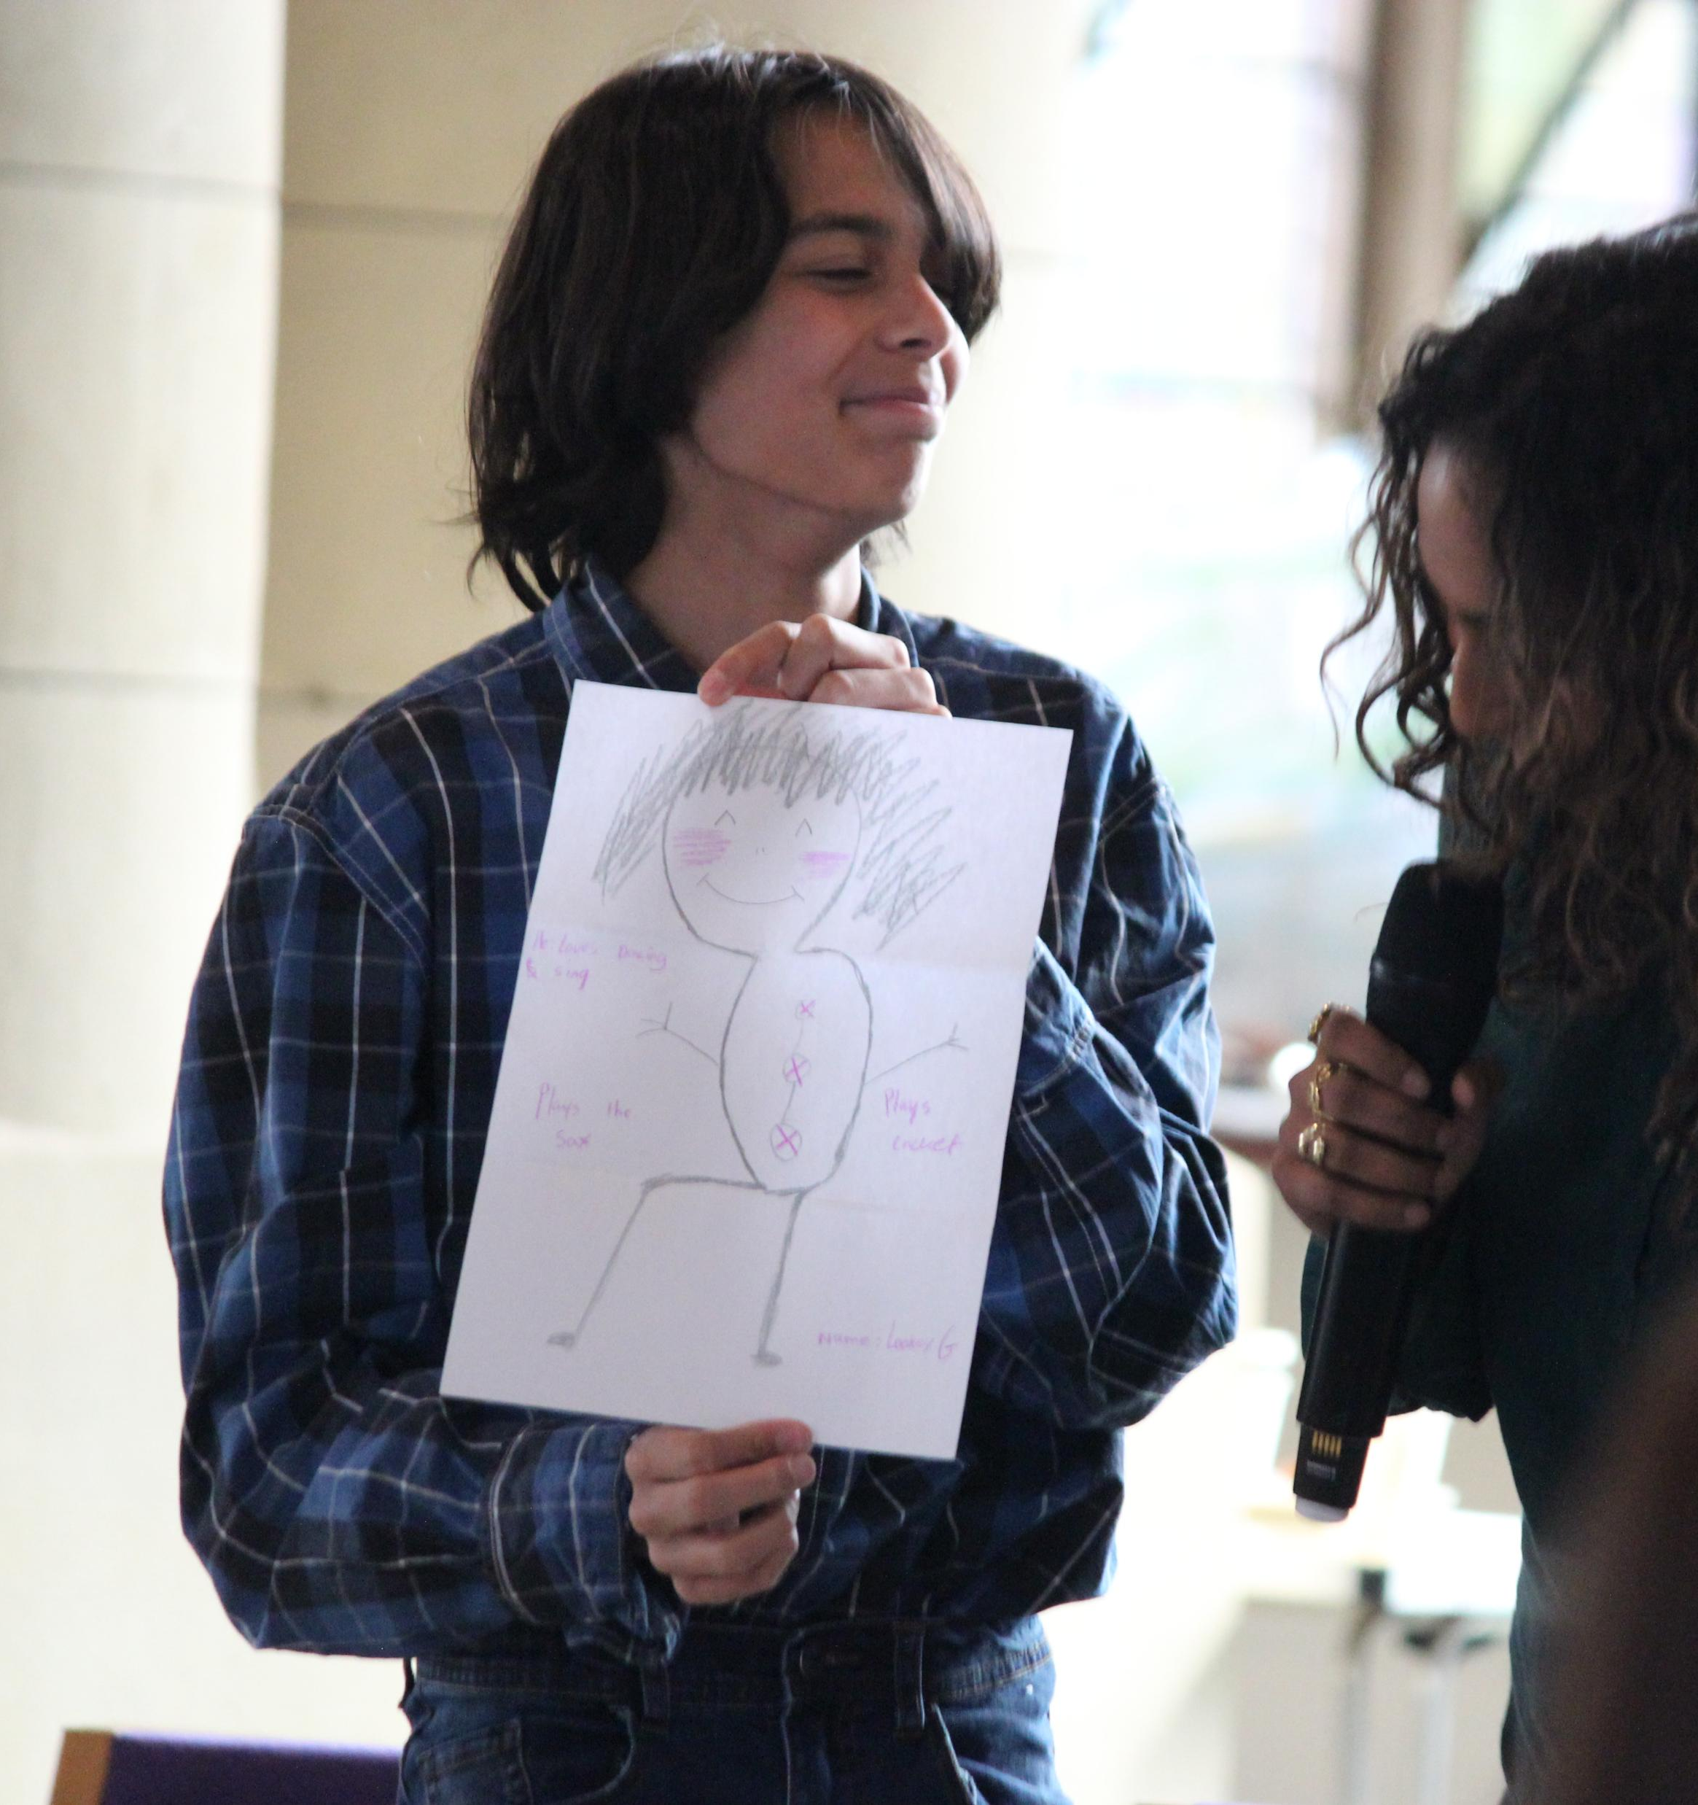
Highlights of the day
Interactive workshops
5-minute ministries panel
Drop-in ministry desks
Service at Canterbury Cathedral

Slide 5
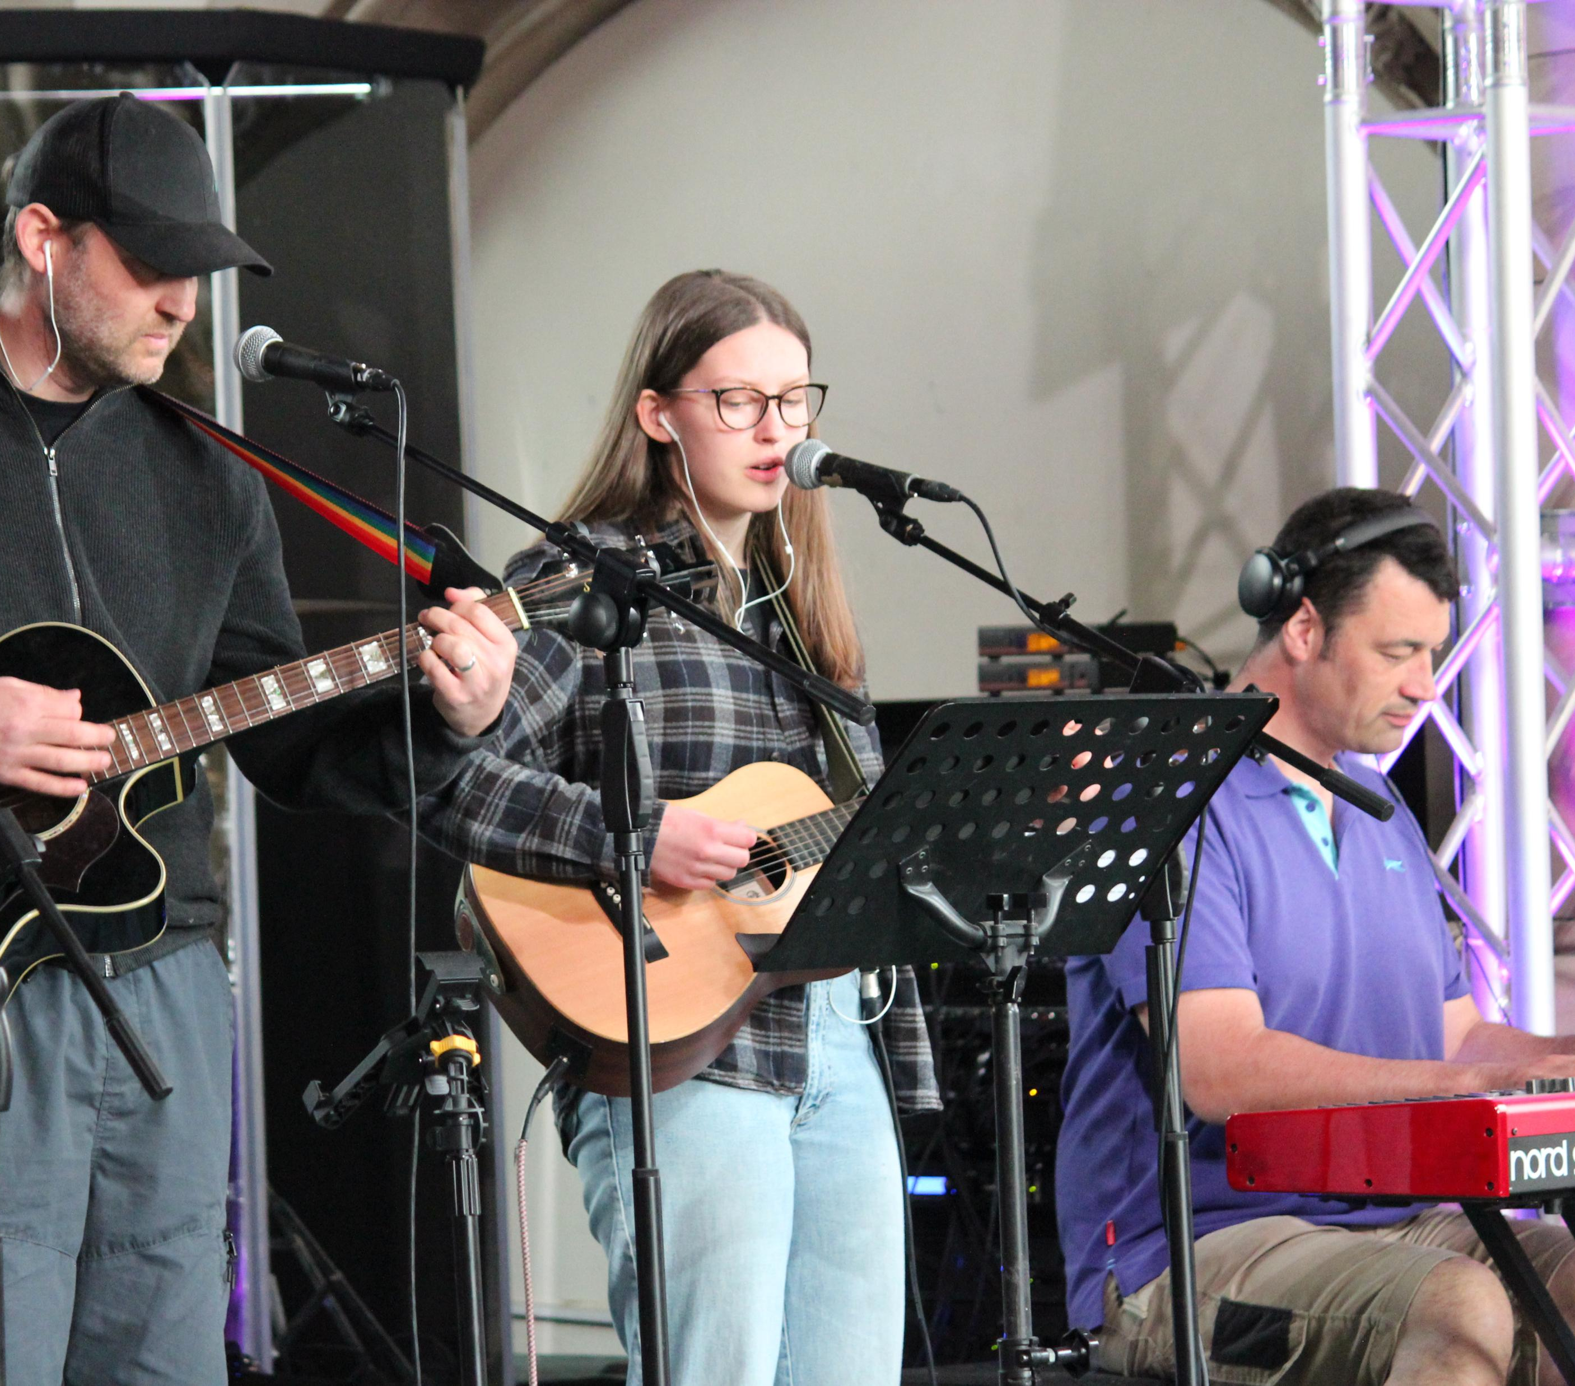
Workshops
Music
Preaching
Intercessions/readings
Everyday faith
Schools ministry
Raising Young Leaders (clergy and youth ministers only)

Slide 6
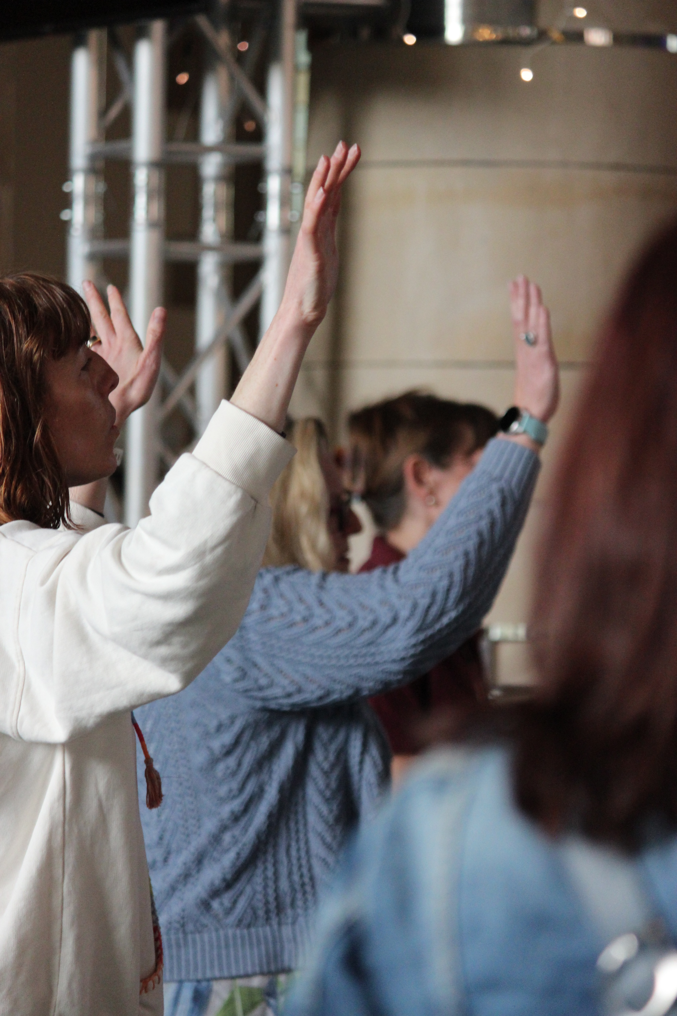
When and where?
Saturday 28 March 2026
10:45am-6pm
St Paul’s Church, Canterbury, finishing with a service at Canterbury Cathedral
Cost? Free!

Slide 7
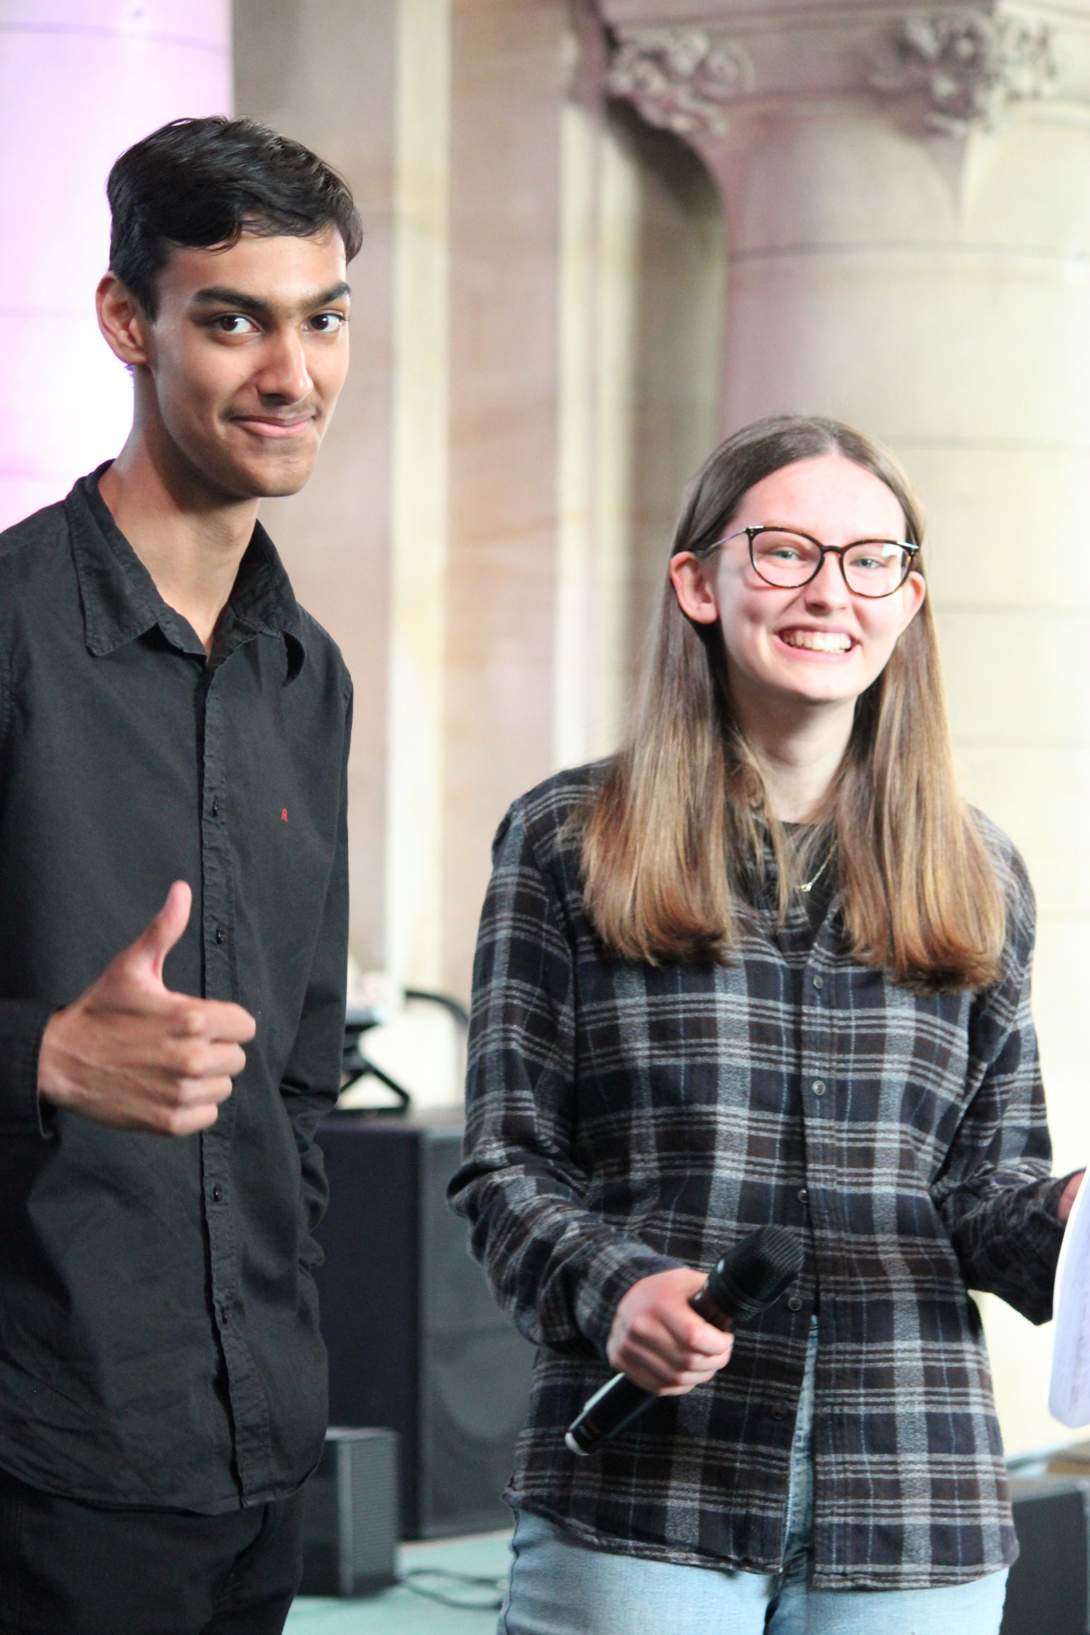
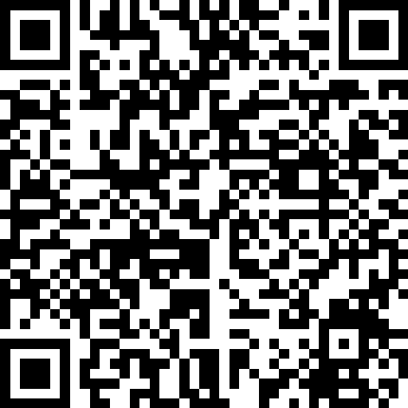
Interested?
18 or over? You can sign up yourself!
Under 18? Get your parent/guardian to sign up for you
Sign up
click.canterburydiocese.org/GYV26

