Slide 1
CDBF Financial Projections
2025 - 2030
Diocesan Synod
3rd July 2024

Slide 2
CDBF Synod Financial Projections 2025 - 2030
Our Calling to God’s Mission
Background to Financial Projections
Circles of Concern, Influence and Control
Our Calling to Each Other
Main Expenditure Categories
How Do Our Support Costs Compare?
How Will Our Strategy Impact Our Finances?
Our Response: 3 Scenarios
Our Calling To God’s Generosity
Summary
Clergy Housing - Not Included In Main Projections
Closing Prayer
Appendix 1: Working Group Members and Organisation
Appendix 2: Assumptions

Slide 3

Our calling to God’s mission…
¹⁸ And Jesus came and said to them, ‘All authority in heaven and on earth has been given to me. ¹⁹ Go therefore and make disciples of all nations, baptizing them in the name of the Father and of the Son and of the Holy Spirit, ²⁰ and teaching them to obey everything that I have commanded you. And remember, I am with you always, to the end of the age.’
Matthew 28: 18-20

Slide 4
Thank you!
for your financial contribution to the life and ministry of our diocese!
for your partnership in the Gospel
for your service to God

Slide 5
Background To Financial Projections
Diocesan Synod Motion November 2023:
“This Synod reluctantly approves the 2024 Diocesan budget and tasks the Archbishops Council with bringing to this Synod, no later than July 2024, credible proposals for ensuring that the CDBF account achieves a sustainable balance of income and expenditure by 2027.”
ABC subsequently agreed that, in addition to the Motion, projections would be extended out to 2030 in order to align with the strategic imperative of the 3 Bold Outcomes.
CDBF established a Working Group to respond to Synod’s Motion.
(Please find details of Working Group members and organisation in Appendix 1)

Slide 6
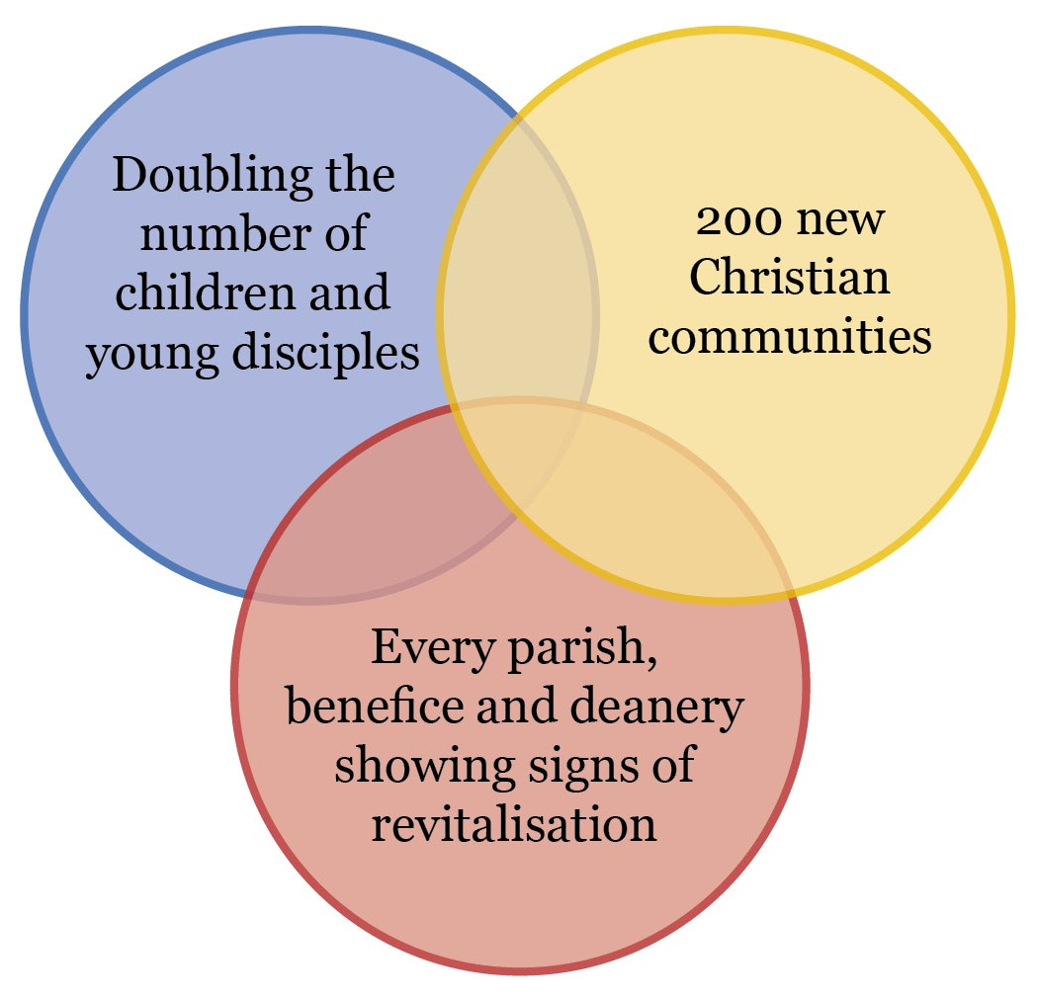
The 3 Bold Outcomes By 2030
New life, in some shape or form, is to be expected, prayed for and worked for everywhere.
Agreed by Diocesan Synod in July 2023

Slide 7
Circles of concern, influence and control (DBF)
Notes
Clergy costs are driven by the number of clergy. We can only influence the cost base when vacancies arise.
We can determine the number of curates but need to maintain a supply line given recruitment issues.
Some of our staffing costs are statutory or mandatory e.g. Financial Accounts & Audit, Safeguarding, clergy Ministerial Development Reviews
Curates
Clergy costs
Parish Share Ask
Control
Staffing costs

Slide 8
Circles of concern, influence and control (DBF)
Notes
PCCs are autonomous. Parish Share payment is variable. Missional activity is expected but discretionary.
Clergy terms of employment are different to normal employment
National church
PCCs
Rental income
Curates
Clergy costs
Clergy
Parish Share Ask
Control
Staffing costs
Influence
Parishioners
Prayers of Love & Faith

Slide 9
Circles of concern, influence and control (DBF)
Church Commissioners
Notes
There are many factors that may impact our financial situation that are beyond our control or influence
Government policy
National church
Inflation
PCCs
Rental income
Curates
Conclusion
DBF/Synod are not masters of our own destiny!
Clergy costs
Clergy
Parish Share Ask
Control
Staffing costs
Wars
Influence
Concern
Parishioners
Prayers of Love & Faith
Charity Commission

Slide 10

Our calling to each other…
⁴ For as in one body we have many members, and not all the members have the same function, ⁵ so we, who are many, are one body in Christ, and individually we are members one of another.
Romans 12: 4-5

Slide 11
How should we operate in such an environment?
The path to success is challenging.
Good collaboration looks like:
Communication – clear, open and free.
Trust – the glue for recognition that we are all interdependent.
Flexibility – within the Church of England and with multiple other stakeholders.

Slide 12
2024 Budget – Income & Expenditure
UNRESTRICTED INCOME | Full Year
Income | Budget
Parish Share cash requested | 7,413,376
Full year LInC grants (allocated) | 796,266
Unallocated LInC grant (accrued) | 67,456
External grants | 40,000
Parochial Fees | 300,000
Other income | 110,000
Investment Fund income | 165,000
Gross rental income | 550,000
Income from trading subsidiaries | 89,000
TOTAL INCOME (UNRESTRICTED) | 9,531,098
UNRESTRICTED EXPENDITURE | Full Year
Expenditure | Budget
Parish Ministry | 7,087,125
Children and Young People | 417,108
Social Justice Network | 108,000
Diocesan Strategy | 85,000
Support Services | 1,818,884
Grants | 15,000
TOTAL EXPENDITURE (UNRESTRICTED) | 9,531,117

Slide 13
Mission & Ministry
Area | Notes | Opportunities to Reduce Cost
Clergy | Cost driven by clergy numbers Every new post is reviewed for local affordability (for 3 years) Reducing clergy numbers reduces the impact, effectiveness and reach of parish and other ministry and ultimately has a negative impact on Parish Share | Can only reduce where a vacancy arises Extend vacancy periods?
Clergy Support | Ministerial Development Reviews – MANDATORY Ministerial support and ongoing development e.g. “the Canterbury Diet” Support for clergy and parishes in difficulty (higher number than expected!) | Clergy well-being is a priority and essential for effective mission!
Ministry Pipeline (Curates etc.) | Developing ministry for the future Exploring calling, training, curacies Experience shows we are largely dependent on curates we have trained to fill our vacancies. Recruitment from outside of our location is not easy | Overall number of stipendiary curates was reduced in 2022 to 4 per year Very limited opportunity to reduce these costs further
Clergy Housing | Maintenance of 167 clergy houses. Historical backlog of repairs. Commitment to improve energy efficiency (to EPC level C) Any houses not in use are rented out. Clergy housing is part of their remuneration package. | Rental income has exceeded budget for several years. Portfolio realistically needs additional investment to increase standards.
Lay ministry | Support for lay ministry which is of increasing importance to work alongside clergy. Increasing uptake at present. Very low-cost model! | No scope to reduce.
Mission | Support for parishes, benefices and deaneries in mission. Missional Learning Communities Prayer calendar and network. | Only one Church Growth Advisor. No scope to reduce further.

Slide 14
Children, Young People, Schools & SJN
Area | Notes | Opportunities to Reduce Cost
Education | Diocesan Board of Education – STATUTORY Working with 105 schools covering c26,000 students Core services agreement with schools for provision of advice, resources and training for an annual contribution. (c£65k income) Training provided to other organisations on a fee basis. | Income generation is in place. Small opportunity to increase further. Income offsets cost of statutory services. Limited scope to generate more income.
Children & Young People | 1.5 FTE Children and Young People Ministry Advisor & Youth work development | No scope to reduce costs especially in view of our Bold Outcome to “Double the number of children and young disciples by 2030”
Social Justice Network | Only core capacity is funded by DBF i.e. Director & Project Administrator Core cost base was reviewed when SJN was formed in 2023. All projects are grant funded from other sources. Note: Oxford diocese fund our refugee officer. | Core capacity is at a minimum realistic level

Slide 15
Support Costs
Area | Notes | Opportunities to Reduce Cost
Finance | Statutory requirement under charity law STATUTORY Must submit audited accounts to Charity Commission | Some services to parishes already reduced or cut to save cost. No additional scope.
Information Technology | Essential business requirement. Costs have increased to keep pace with the increasing demands of cyber security. Cost avoidance! Modern, effective and efficient service that “saved us” during Covid! | Contracts and costs are constantly reviewed to ensure effectiveness and value for money. Helps other teams to be more efficient.
Media & Engagement | High profile diocese, Bishop & Archbishop The glue that helps us be a diocese together Reduced from 2.5 to 2.0 FTE DBF funded posts with capacity grant | No opportunity to reduce further.
Governance | Diocesan Secretary’s office essential to support Synodical governance MANDATORY | Probably under-resourced at present.
Safeguarding | Extremely high profile for Church of England MANDATORY Well-regarded, supportive team providing 24x7 cover Provide service to Cathedral under SLA (£13k) | No opportunity to reduce cost further. Small possibility of generating additional income. High risk if reduced.
Office facilities | Already consolidated from 3 to 1 offices to reduce costs Relocation not financially feasible when last reviewed (2018/2019) | Little scope to reduce further.
Programme Office (Strategy) | Team all met through national capacity funding. General Fund only contributes £85k p.a. which funds projects. | No opportunity. £4m+ investment generated since 2023!
Carbon Net Zero | Mostly funded by national team. Very limited capacity. Local budget <£10k p.a.!!! | We probably ought to be investing more!

Slide 16
How do our Support costs compare?
Not for profit sector
Admin expense ratio: 19% vs Range 15% to 25%
Other dioceses
Headcount in line with similar dioceses
More detailed study expected summer 2024
Parish Share collection: 90% vs Average 90%
Conclusion
Support costs are reasonable
A focus on efficiency and cost reduction has already enabled improvements and savings

Slide 17
How will our Strategy impact our Finances?
Area | Notes | Opportunities to increase income
Youth Ministers | Objective to double number of young people in those churches Expectation that this will attract families Over time, increased income from these will hopefully fund the youth minister as the grant reduces over five years | Medium/Long Term – will generate a small net income
Youthscape LaunchPad | Enabling start-up and growth in youth ministry | Medium Term – may attract additional families with potential for some increase in income.
Resourcing Churches | Investment in ministry resources to achieve growth Looking for rapid growth but likely to start modestly Giving anticipated to grow to meet reducing grants over 5 years | Medium/Long Term will pay a higher proportion of overall Parish Share. Long Term benefit from new plants/ revitalisations
Ignite Phase 2 | Establishing new Christian communities A home-grown successful model Useful for disadvantaged communities, families, youth etc | Target demographics may not bring significant financial contribution
Every parish… showing signs of revitalisation | Support parishes in completing a Mission Action Plan Support parishes in exploring ways to grow or perhaps consolidate Support parishes in looking at giving and generosity Generous Giving Advisor can help | Potential to grow income from existing base Missional growth should also lead to financial growth – perhaps with a lag Invest in another Generous Giving Advisor?
Blue sky! | Expanding resourcing churches into other urban areas Develop models suitable for rural/semi-rural areas Try some new things and accept they won’t all work How do we improve scale and pace? (“get more rubber on the road”) | Medium/Long Term could generate financial growth

Slide 18
Our Response: 3 Scenarios
Scenario 1: Continued decline
Parish Share contribution falls off slightly. Rental revenues and sale of assets (vicarages) continue to cross subsidise Parish Share shortfall.
Scenario 2: Moderate Growth
Some areas achieve 3 Bold Outcomes by 2030 but a number of other areas do not achieve. Growth in attendance in some parishes. Parish Share contribution improves but insufficient to cover costs.
Scenario 3: Significant Growth
Most areas achieve 3 Bold Outcomes. Most parishes seeing growth or halt in decline. Parish Share contribution improves but still insufficient to cover costs.
See Appendix 2 for Assumptions

Slide 19
Modelling the 3 Scenarios
Notes
Growth based on attendance data vs 2019 (+/- 3%)
Scenarios forecast a changing profile of growth/ decline
Parish Share income vs ask modelled for each scenario

Slide 20
3 Scenarios with projected Parish Share receipts

Slide 21
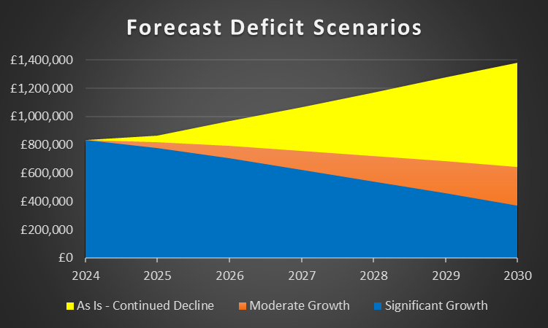
All 3 scenarios forecast a significant deficit
How can the deficit be financed?
Reduce costs – little scope
Re-introduce contingency in budget
Generosity
Use of Reserves
Sale of Assets
Support from national church?

Slide 22
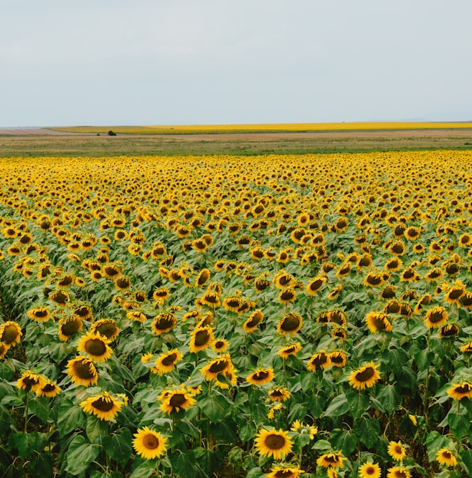
Our calling to God’s generosity…
You will be enriched in every way for your great generosity, which will produce thanksgiving to God through us; ¹² for the rendering of this ministry not only supplies the needs of the saints but also overflows with many thanksgivings to God.
2 Corinthians 9: 11-12

Slide 23
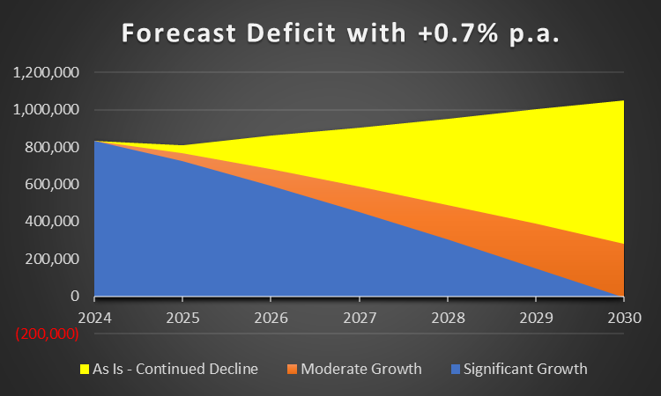
Impact of adding 0.7% extra each year
How can the deficit be financed?
Reduce costs – little scope
Re-introduce contingency in budget
Generosity
Use of Reserves
Sale of Assets
Support from national church?
Shows break-even in 2030 in Significant Growth scenario

Slide 24
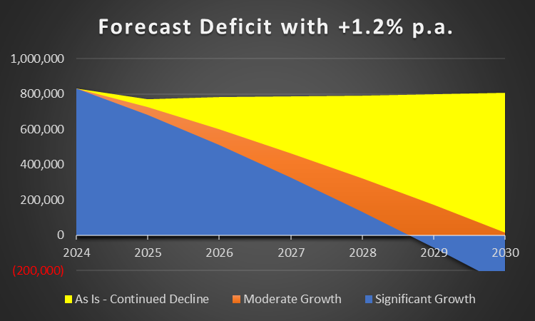
Impact of adding 1.2% extra each year
How can the deficit be financed?
Reduce costs – little scope
Re-introduce contingency in budget
Generosity
Use of Reserves
Sale of Assets
Support from national church?
Shows break-even in 2030 in Moderate Growth scenario
Shows break-even in 2029 for Significant Growth scenario

Slide 25
Scenarios Summary
The is no significant opportunity to reduce costs
Our strategy will help with the financial position in the growth scenarios
In the short to medium term we will need to focus on giving and generosity, sale of assets and helping PCCs build financial resilience
Synod/CDBF can only influence parishes but will look to find investment to support growth
Mutuality and generosity will be key – we are one body!

Slide 26
Inevitable Decline or Growth through Investment?
Our diocesan finances (DBF + parishes) are not entirely dissimilar to national finances in a time of recession
Cutting costs (beyond driving appropriate efficiencies) leads to reduced resources and further decline
Most economists advocate an investment approach to drive growth
“Wake up! Make yourselves stronger before what little strength you have left is completely gone.”
Rev 3:2a ERV
?
How can we all make a difference?

Slide 27
Clergy Housing
Not included in financial projections

Slide 28

Clergy Housing – The uncomfortable facts
167 properties
Backlog of works: £1.7m (£0.6m urgent in 2024/5)
Does not include any improvement works!
The historical budget was not sufficient and was cut
The Property Team have been expected to work “miracles”!
The annual maintenance budget needs to be increased
Additional investment has not been included in the projections

Slide 29
Clergy Housing – Why we need to invest
Poor housing is a deterrent to recruitment and demoralising for those already living in poor housing
Clergy well-being has to be a priority
Housing is provided for the “better performance” of the duties of office
Good housing ought to be the standard, not the exception

Slide 30
Clergy Housing – How to fund investment?
Rental incomes are likely to be £250k-£300k higher than currently budgeted for
Are there other ways that the asset base could be used to fund investment?
Further sales should not be ruled out – we need effective housing in the right place
National church will be approached for support in this key area

Slide 31



Our calling to God’s generosity…
Our calling to God’s mission…
Our calling to each other…

Slide 32
Let us pray…
God of life and love,
as we hear your call to mission,
lead us to envision a bold future
while acknowledging our present reality.
Show us how to value each other’s talents and gifts
and make us Spirit-filled generous disciples
as together we grow your Kingdom,
through Jesus Christ our Lord and Saviour. Amen.

Slide 33
Appendix 1: Working Group Organisation
Working Group Members
  Tony Richter – Deanery Treasurer, Acting Chair, Diocesan Finance Board
  Jack Fellows – Parish Warden, former Parish Treasurer, Finance Board Member
  Caroline Highwood – former Parish Treasurer, Finance Board Member
  Shirley Leslie – Parish Treasurer, Finance Board Member
  Iain Blythe, Diocesan Secretary
  Natalia Olszewska – Diocese Finance Director
  Colin Evans – Strategic Programme Manager
The Working Group met 3 times to date
  5th April
  22nd April
  10th May
  ???
Presentations were made to Finance Board 14th May and Archbishop’s Council 1st June

Slide 34
Appendix 2: Assumptions
No Major geo-political upheaval (e.g. war in Europe, Middle East).
No Major global upheaval (e.g. pandemic).
Costs relating to carbon neutral by 2030 – primarily covered by external grants.
Core Strategy Team continues to be funded by national grant
No impact of changes to the Rent Act

Slide 35
Backup Slides

Slide 36
Financial & Missional Strength – possible approach
Missional Strength
Attendance trajectory
Growing
Financial Action Plan
Consider PGS
Support from Generous Giving Advisor
Additional Generous Giving Advisor?
Static
Mission Action Plan
Noticing & Naming
Leading your Church into Growth course
Missional Learning Community?
Support from Mission & Growth Advisor
Deanery Review
Declining
Financial Strength
Percentage payment of Parish Share
<75%
75%-99%
100%

