Slide 1
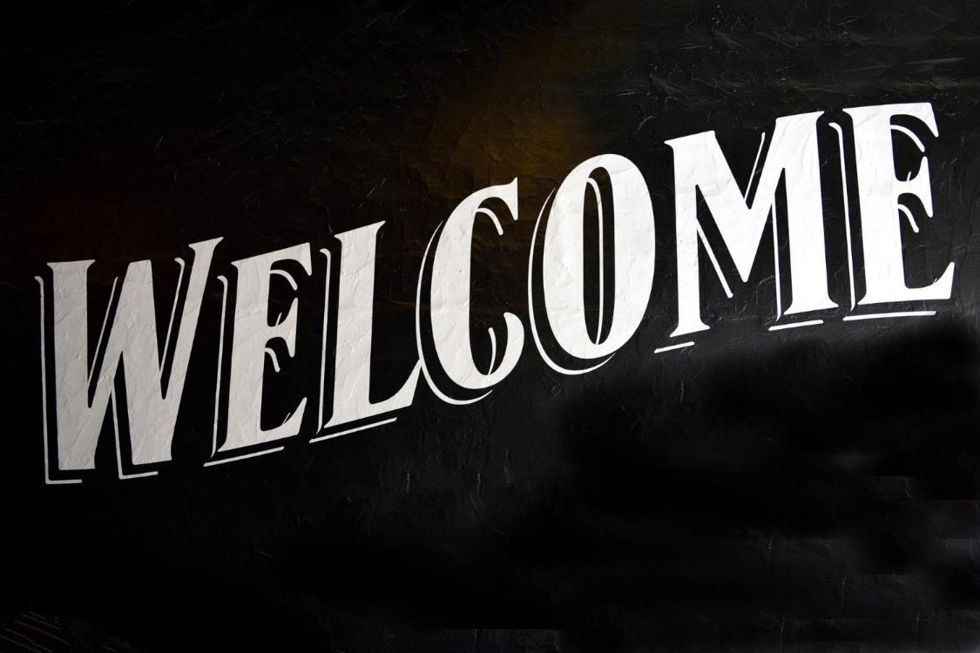
Pictures in this presentation are copyright-free from pixabay
Notes:
Slide 1: Use your usual gathering greeting to welcome your school community

Slide 2
Notes:
Slide 2: Last week, we thought about how our school community is a bit like a jigsaw puzzle. [If time allows, let children share their thoughts from last time]

Slide 3
Nehemiah’s Big Rebuild
Notes:
Slide 3: We heard the beginning of the story of Nehemiah’s Big Re-Build, and we thought about how we, like some of God’s people in the story, are back together again, while part of our school community is still not with us. Like the people, we are getting our school and our hearts ready for the time when we will all be back together again.

Slide 4
Notes:
We are Rebuilding Our Community (slide 4)

Slide 5
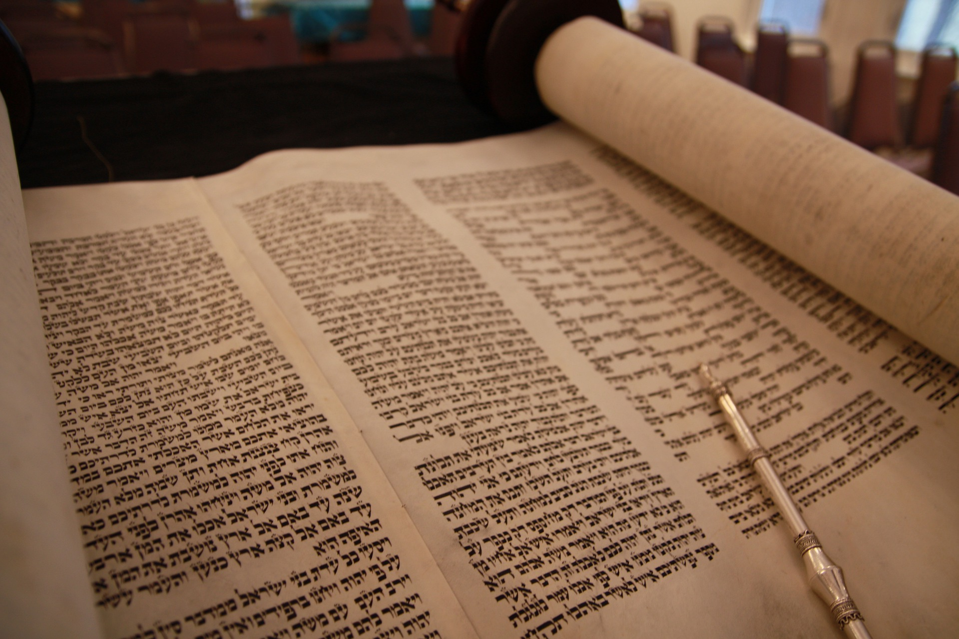
Nehemiah’s Big Rebuild – part 2!
Notes:
Slide 5: In today’s part of the story, we hear how Ezra the teacher read to God’s people from the special scroll – which some of you may remember is called the Torah – and we are going to make our own scrolls as part of our reflection time….
So let’s find out how Nehemiah’s Big Rebuild is getting on and hear what was read from the scrolls…. …and how those words helped to re-build the peoples’ hearts. [use script]

Slide 6
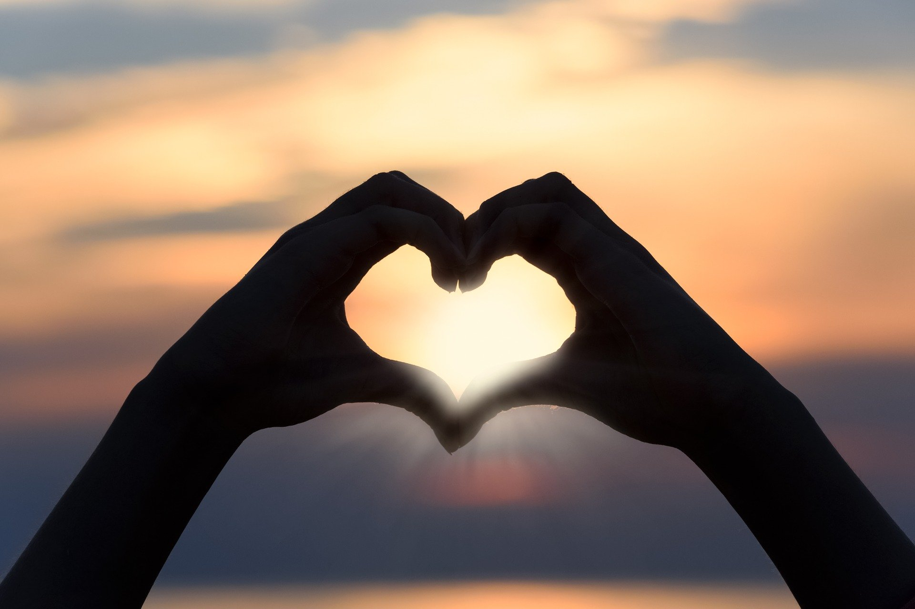
Notes:
Slide 6: To help children to engage: every time you hear the word ‘hearts’ make a heart shape with your hands

Slide 7

God, Blessed be your wonderful name. Your name is more wonderful than all blessing and praise. You are the only Lord. ….You give life to everything. Because of your mercy, you saved us again and again. You were patient with us for many years.
…..our God, you are the great and mighty and wonderful God. You keep your agreement of love.’
Scroll Prayer
Notes:
Slide 7: Responding (and words for worship):
…We’ve been thinking today about the story of Nehemiah’s rebuild ….
….how the memories the people shared made them both sad, and happy….(and both feelings are OK!....)
…the words that Ezra read from the Torah helped to rebuild the peoples’ hearts….
….the great stories of their past helped them to remember who they were….
….and it reminded them of who God was as well, and how he’d always cared for them….
….the words also gave them a reason to celebrate….
….Nehemiah wrote in his story that there had never been a celebration like it!....
…..I wonder why?.....
We’re going to pause now and I’m going to pray using some of the words that the people prayed as they celebrated together. If you want to, you can make this your prayer as well….[words also animated in PPT)
‘God, Blessed be your wonderful name. Your name is more wonderful than all blessing and praise. You are the only Lord. ….You give life to everything. Because of your mercy, you saved us again and again.
You were patient with us for many years. ....our God, you are the great and mighty and wonderful God.
You keep your agreement of love.’
[Nehemiah 9:5-6, 28, 30 & 32 ICB]

Slide 8
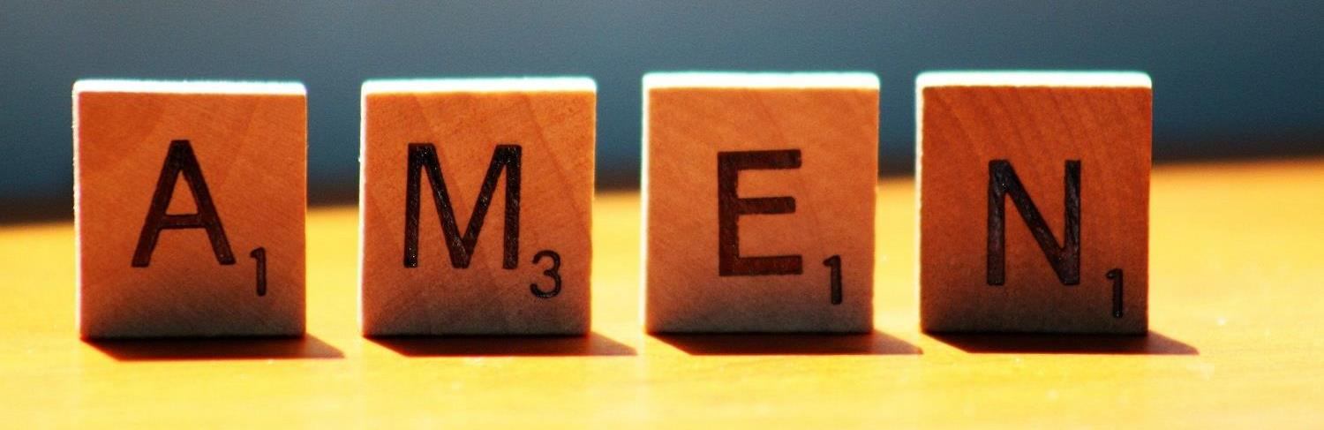

Slide 9
Share your ‘story’
What’s been important to you during lockdown?
Scroll Reflections
Notes:
Slide 9: Sharing our stories
….we’ve all been apart for the last few months…..
….I wonder what’s been important to you during lockdown?....
….I wonder which words have been important to you in this time?....
….I wonder what stories you might share with others about your lockdown experiences?....
….take some time to write or draw your thoughts onto your scroll….
[then roll them up – Torah-style if you can!]

