Slide 1
GDPR FOR CHURCHES
Ashford Archdeaconry
12 April 2018

Slide 2
WHAT IS GDPR?
“GDPR rebalances the relationship between individuals and organisations. It gives greater control to people about how their data is used and it compels organisations to be transparent and account for their actions.”
Elizabeth Denham, Information Commissioner
Notes:
The General Data Protection Regulation (GDPR) (EU) 2016/679 is a regulation in EU law on data protection and privacy for all individuals within the European Union.
Update to data protection act 1998
Some key changes

Slide 3
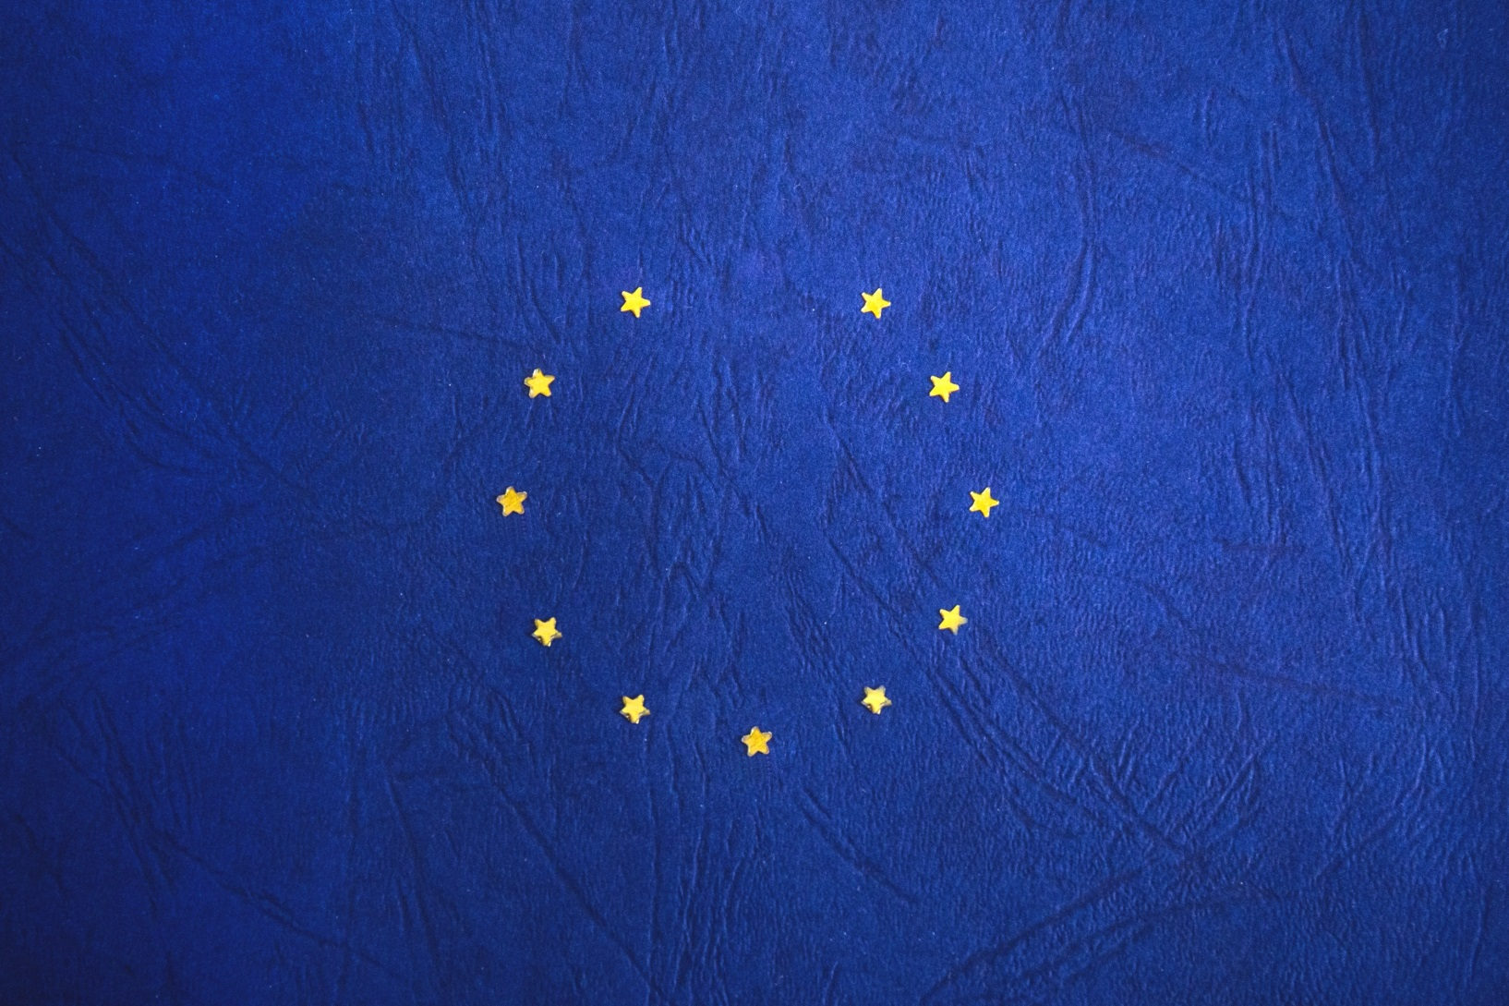
WHAT ABOUT BREXIT?

Slide 4
Key terms
Personal data: information about a living individual which is capable of identifying that individual. Data subject
Data subject: person about whom personal data is processed
Data controller: person/organisation who determines the how and what of data processing
Data processor: responsible for processing personal data on behalf of a controller
Processing: anything done with/to personal data, including storing it
Notes:
* Personal data: e.g names, email addresses, photos.
* Data controller: in a parish, this would usually be the PCC or incumbent.

Slide 5
Key principles
Personal data must:
be processed lawfully, fairly and transparently
only used for a specific processing purpose that the data subject is aware of - and no other without further consent
be "adequate, relevant and limited"
be "accurate and where necessary kept up to date"
not be stored for longer than is necessary
be processed in a manner that ensures appropriate security and protection
Notes:
* Adequate, relevant & limited - i.e. only the minimum amount of data should be kept for specific processing.

Slide 6
What’s new?
Consent: informed, opt-in
New rights for data subjects
Data should only be used for purpose it was gathered for & deleted when no longer required
Tougher sanctions for non-compliance & for sharing data outside the EEA
Staff & data users should have suitable training & advice
Serious data breaches must be reported to ICO within 72 hrs
Principle of accountability – onus on data controller
Notes:
The rights of data subjects usually trump everything else.
Accountability – document what you’ve done to try to ensure compliance.

Slide 7
Rights of the data subject
The right to be informed
The right of access
The right to rectification
The right to erasure
The right to restrict processing
The right to data portability
The right to object
Rights in relation to automated decision making and profiling.
Notes:
The rights of data subjects usually trump everything else.
Individuals have the right to be informed about the collection and use of their personal data. This is a key transparency requirement under the GDPR. You must provide individuals with information including: your purposes for processing their personal data, your retention periods for that personal data, and who it will be shared with. We call this ‘privacy information’. You must provide privacy information to individuals at the time you collect their personal data from them. If you obtain personal data from other sources, you must provide individuals with privacy information within a reasonable period of obtaining the data and no later than one month.
Individuals have the right to access their personal data and supplementary information. The right of access allows individuals to be aware of and verify the lawfulness of the processing.
The GDPR includes a right for individuals to have inaccurate personal data rectified, or completed if it is incomplete. An individual can make a request for rectification verbally or in writing. You have one calendar month to respond to a request. In certain circumstances you can refuse a request for rectification.
Aka ‘the right to be forgotten’. GDPR introduces a right for individuals to have personal data erased. Individuals can make a request for erasure verbally or in writing. You have one month to respond to a request. The right is not absolute and only applies in certain circumstances. This right is not the only way in which the GDPR places an obligation on you to consider whether to delete personal data.
Individuals have the right to request the restriction or suppression of their personal data. This is not an absolute right and only applies in certain circumstances. When processing is restricted, you are permitted to store the personal data, but not use it. An individual can make a request for restriction verbally or in writing. You have one calendar month to respond to a request.
The right to data portability allows individuals to obtain and reuse their personal data for their own purposes across different services. It allows them to move, copy or transfer personal data easily from one IT environment to another in a safe and secure way, without hindrance to usability. It enables consumers to take advantage of applications and services which can use this data to find them a better deal, or help them understand their spending habits.
Individuals have the right to object to:
processing based on legitimate interests or the performance of a task in the public interest/exercise of official authority (including profiling);
direct marketing (including profiling); and
processing for purposes of scientific/historical research and statistics.
8. The GDPR has provisions on:
automated individual decision-making (making a decision solely by automated means without any human involvement)
profiling (automated processing of personal data to evaluate certain things about an individual). Profiling can be part of an automated decision-making process.

Slide 8

Don’t panic
Notes:
If you’re already compliant with DPA 1998, there’s not a huge amount you will need to do to ensure compliance for your parish
Although there are increased fines for non-compliance, parish churches are really not going to be at the top of the ICO’s hit list come 25 May this year. What you can do, is document everything you’re doing to be doing to work towards compliance. Then – on the off-chance that you have to report a data breach, or that you get a call from the ICO, you will be able to show that you are taking all reasonable steps to protect data subjects.
We are here to help you. There will be time for questions at the end of the session. There may be questions we can’t answer here and now, but we will be happy to look into anything that falls into that category and come back to you.

Slide 9
Legal basis for holding data
Consent
Contract
Legal obligation
Vital interests
Public task
Legitimate interest
Notes:
Before you hold or process data on a Data Subject, you must make sure that you have a lawful basis for doing so.
These are the different lawful bases:
(a) Consent: the individual has given clear consent for you to process their personal data for a specific purpose.
(b) Contract: the processing is necessary for a contract you have with the individual, or because they have asked you to take specific steps before entering into a contract.
(c) Legal obligation: the processing is necessary for you to comply with the law (not including contractual obligations).
(d) Vital interests: the processing is necessary to protect someone’s life.
(e) Public task: the processing is necessary for you to perform a task in the public interest or for your official functions, and the task or function has a clear basis in law.
(f) Legitimate interests: the processing is necessary for your legitimate interests or the legitimate interests of a third party unless there is a good reason to protect the individual’s personal data which overrides those legitimate interests. (This cannot apply if you are a public authority processing data to perform your official tasks.)
It is the controller’s responsibility to be able to demonstrate which lawful basis applies to the particular processing purpose – and to make this clear to the data subject. You need to include information about your lawful basis (or bases, if more than one applies) in your privacy notice.
So, for example:
Example 1
A company decided to process on the basis of consent, and obtained consent from individuals. An individual subsequently decided to withdraw their consent to the processing of their data, as is their right. However, the company wanted to keep processing the data so decided to continue the processing on the basis of legitimate interests.
Even if it could have originally relied on legitimate interests, the company cannot do so at a later date – it cannot switch basis when it realised that the original chosen basis was inappropriate (in this case, because it did not want to offer the individual genuine ongoing control). It should have made clear to the individual from the start that it was processing on the basis of legitimate interests. Leading the individual to believe they had a choice is inherently unfair if that choice will be irrelevant. The company must therefore stop processing when the individual withdraws consent.
Example 2
A wedding couple will give you their details in order that you can complete your ‘contact’ to marry them. Your legal basis for processing this information will be ‘Contract’, not ‘Consent’. However, if you want to retain their information and use it to be in touch with them about anything else (for example, add to your newsletter or send ‘happy anniversary’ cards), you will need their consent for that. This will best be obtained during your contact with the couple in arranging their wedding, but you will need to be clear with them that your contract with them is not conditional upon them giving consent for further contact – we’ll talk about consent next…

Slide 10
Special category data
race
ethnic origin
politics
religion
trade union membership
genetics
biometrics
health
sex life
sexual orientation
Notes:
Special category data is personal data which the GDPR says is more sensitive, and so needs more protection.
In order to lawfully process special category data, you must identify both a lawful basis under Article 6 AND a separate condition for processing special category data under Article 9. These do not have to be linked.
There are ten conditions for processing special category data in the GDPR itself, but the Data Protection Bill will introduce additional conditions and safeguards.
You must determine your condition for processing special category data before you begin this processing under the GDPR, and you should document it.

Slide 11
Processing Special category data
Explicit consent
Employment law
Vital interests
Charities, religious organisations, and not-for-profit
Made public by data subject
Legal claims
Public interest
Medical diagnosis/treatment
Public health
Historical, statistical or scientific purposes
Notes:
the data subject has given explicit consent to the processing of those personal data for one or more specified purposes, except where Union or Member State law provide that the prohibition referred to in paragraph 1 may not be lifted by the data subject;
processing is necessary for the purposes of carrying out the obligations and exercising specific rights of the controller or of the data subject in the field of employment and social security and social protection law in so far as it is authorised by Union or Member State law or a collective agreement pursuant to Member State law providing for appropriate safeguards for the fundamental rights and the interests of the data subject;
processing is necessary to protect the vital interests of the data subject or of another natural person where the data subject is physically or legally incapable of giving consent;
processing is carried out in the course of its legitimate activities with appropriate safeguards by a foundation, association or any other not-for-profit body with a political, philosophical, religious or trade union aim and on condition that the processing relates solely to the members or to former members of the body or to persons who have regular contact with it in connection with its purposes and that the personal data are not disclosed outside that body without the consent of the data subjects;
processing relates to personal data which are manifestly made public by the data subject;
processing is necessary for the establishment, exercise or defence of legal claims or whenever courts are acting in their judicial capacity;
processing is necessary for reasons of substantial public interest, on the basis of Union or Member State law which shall be proportionate to the aim pursued, respect the essence of the right to data protection and provide for suitable and specific measures to safeguard the fundamental rights and the interests of the data subject;
processing is necessary for the purposes of preventive or occupational medicine, for the assessment of the working capacity of the employee, medical diagnosis, the provision of health or social care or treatment or the management of health or social care systems and services on the basis of Union or Member State law or pursuant to contract with a health professional and subject to the conditions and safeguards referred to in paragraph 3;
processing is necessary for reasons of public interest in the area of public health, such as protecting against serious cross-border threats to health or ensuring high standards of quality and safety of health care and of medicinal products or medical devices, on the basis of Union or Member State law which provides for suitable and specific measures to safeguard the rights and freedoms of the data subject, in particular professional secrecy;
processing is necessary for archiving purposes in the public interest, scientific or historical research purposes or statistical purposes in accordance with Article 89(1) based on Union or Member State law which shall be proportionate to the aim pursued, respect the essence of the right to data protection and provide for suitable and specific measures to safeguard the fundamental rights and the interests of the data subject.
In a parish context the most relevant lawful bases for processing under Special Category Data are likely to be 1 and 4, namely:
Explicit consent from a person; or
4. Where the processing is the legitimate activity of the organisation (ours being a ‘religious organisation’) and relates to either members or former members or to individuals with whom there is regular contact, but is not disclosed to any third parties without explicit consent.

Slide 12
consent
“…any freely-given, specific, informed and unambiguous indication of the data subject’s wishes by which he or she, by a statement or by clear affirmative action, signifies agreement to the processing of personal data relating to him or her.”
Notes:
The GDPR sets a high standard for consent. But you often won’t need consent. If consent is difficult, look for a different lawful basis.
Opt-in – no pre-ticked boxes, or ‘tick here if you do not want to…’
Consent will apply in most cases to members of the church community (such as ordinary church goers) but not to personal data which is processed in connection with a person’s role in the church (even where the role is voluntary). Those with roles cannot give valid consent because consent has to be freely given, and can be withdrawn at any stage. This is not compatible with the situation in which a person must give consent in order to be appointed, and in which any later withdrawal of the consent would leave the parish in an impossible situation.
Consent for one element of data processing does not give you permission to do anything else with it. You cannot mail everyone on your electoral roll, or even everyone for whom you have a Gift Aid declaration, with fundraising communications. You need further consent. Where you collect consents, e.g. to be added to an email mailing list, you will need to store those consents. You are likely to need several different consent forms (or elements within a single form) to cover different areas of data processing within the life of the church.

Slide 13
consent
Unbundled
Active opt-in
Granular
Named
Documented
Easy to withdraw
No imbalance in relationship
Notes:
The GDPR sets a high standard for consent. But you often won’t need consent. If consent is difficult, look for a different lawful basis.
Unbundled
– consent must be separate from other terms and conditions
• Active Opt-in
– pre-ticked opt in boxes are invalid
• Granular
– consent needed for each processing activity
• Named
– your organisation and any third party who will be relying on consent.
• Documented
– keep records of consent, what individual told, when and how they consented
Consent will apply in most cases to members of the church community (such as ordinary church goers) but not to personal data which is processed in connection with a person’s role in the church (even where the role is voluntary). Those with roles cannot give valid consent because consent has to be freely given, and can be withdrawn at any stage. This is not compatible with the situation in which a person must give consent in order to be appointed, and in which any later withdrawal of the consent would leave the parish in an impossible situation.
Consent for one element of data processing does not give you permission to do anything else with it. You cannot mail everyone on your electoral roll, or even everyone for whom you have a Gift Aid declaration, with fundraising communications. You need further consent. Where you collect consents, e.g. to be added to an email mailing list, you will need to store those consents. You are likely to need several different consent forms (or elements within a single form) to cover different areas of data processing within the life of the church.

Slide 14
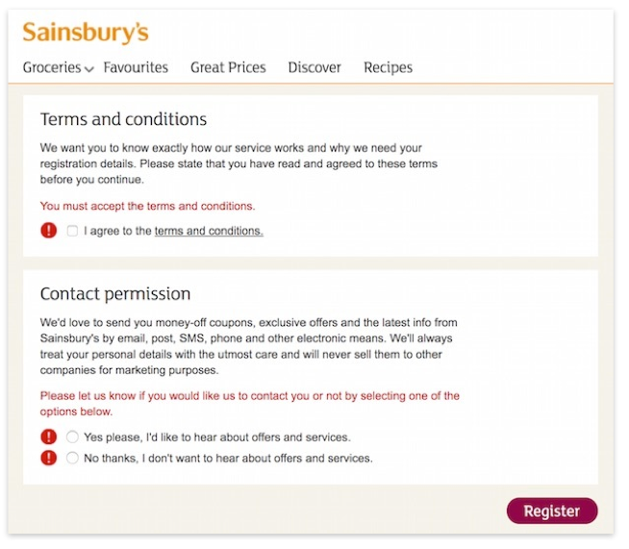
Notes:
For role holders such as churchwardens, members of the clergy and volunteers, you cannot rely on their consent because under GDPR (and the present law) consent must be freely given. As it is necessary to process certain data for these role holders so that they can perform their roles, it is not the case that consent can be truly “freely given”. Anyone can also withdraw their consent at any time. Therefore it is not appropriate to rely on consent as a legal ground for processing personal data for role holders.
We have designed two types of Privacy Notice for role holders and non role holders and you can find these in Appendix 5 – Privacy Notices. We have designed the Privacy Notices so that one notice is sent to each individual so the individual data controllers will not have to send a separate Privacy Notice unless they start using personal data for a purpose not listed in the Privacy Notice or start sharing personal data with a third party not listed in the notice.

Slide 15
Consent & role holders
Consent can’t be “freely given” by role-holders, even volunteers
Use a different legal basis for processing their data in relation to their role & responsibilities
BUT ensure consent for any intended data processing unrelated to their role (e.g. prayer lists)
Separate privacy notice in packs
Notes:
For role holders such as churchwardens, members of the clergy and volunteers, you cannot rely on their consent because under GDPR (and the present law) consent must be freely given. As it is necessary to process certain data for these role holders so that they can perform their roles, it is not the case that consent can be truly “freely given”. Anyone can also withdraw their consent at any time. Therefore it is not appropriate to rely on consent as a legal ground for processing personal data for role holders.
We have designed two types of Privacy Notice for role holders and non role holders and you can find these in Appendix 5 – Privacy Notices. We have designed the Privacy Notices so that one notice is sent to each individual so the individual data controllers will not have to send a separate Privacy Notice unless they start using personal data for a purpose not listed in the Privacy Notice or start sharing personal data with a third party not listed in the notice.

Slide 16
Legitimate interest
Most flexible – but more responsibility
3 part test:
Identify a legitimate interest
Show that the processing is necessary to achieve it
Balance it against the individual’s interests, rights and freedoms.
Document it
Notes:
Legitimate interests is the most flexible lawful basis for processing, but you cannot assume it will always be the most appropriate.
It is likely to be most appropriate where you use people’s data in ways they would reasonably expect and which have a minimal privacy impact, or where there is a compelling justification for the processing.
If you choose to rely on legitimate interests, you are taking on extra responsibility for considering and protecting people’s rights and interests.
The legitimate interests can be your own interests or the interests of third parties. They can include commercial interests, individual interests or broader societal benefits.
The processing must be necessary. If you can reasonably achieve the same result in another less intrusive way, legitimate interests will not apply.
You must balance your interests against the individual’s. If they would not reasonably expect the processing, or if it would cause unjustified harm, their interests are likely to override your legitimate interests.
Keep a record of your legitimate interests assessment (LIA) to help you demonstrate compliance if required.
You must include details of your legitimate interests in your privacy information.

Slide 17

breathe

Slide 18
Gift Aid
Consent needed on declarations
Oct ’17 – 12,655 declarations but only 5,300 active
To date have received approx 4,400
As at 25 May, all non-GDPR declarations will expire
Notes:
For gift aid, donors have always needed to complete appropriate declaration. The required GDPR consent is now built into the declaration. All gift aid donors have to complete the new GDPR declaration.
Consent is needed because parish and diocese and legally separate organisations and personal data obtained by the parish is forwarded to the diocese.
Active declarations are those where a donation has been processed in the last two years.
The figure of 4,100 is constantly being updated as we are receiving dozens of new forms every day. It is worth noting that as parishes have undertaken this exercise, other amendments have come to light (change of address, change of tax status, death of donor) – some of these amendments are years overdue. Many parishes have also found numerous new gift aid donors.

Slide 19
Gift Aid
One-off declarations (pew envelopes) also need to have consent built in
We can provide stickers for existing stocks
If re-ordering, ensure wording is compliant
Notes:
The stickers cost 35p per sheet of 24.
Envelope Systems (01767 681717 https://www.envelopesystems.co.uk) have reworded their envelopes specifically for Canterbury Diocese. Please let them know you are from this diocese.

Slide 20
Gift Aid
Legitimate Interest for gift aid secretaries / treasurers
All data to be retained for seven years*
Notes:
When we wrote out on October we also asked for consent from GA Secretaries. This is not needed as we will retain data under legitimate interest. It was sensible to do at the time as full details of GDPR where unknown. If you have not returned the consent form then please feel free to still do so. This will enable us to check our records for accuracy and add phone and email.
Seven years is actually the current year plus six. Therefore data received on 1st December is to be retained six years and one month. This is under the various Finance Acts and these supersede GDPR

Slide 21
CONTACT LISTS
Consent or Legitimate Interest?
Be clear
Make sure people know their rights

Slide 22
children
If you process children’s data, their protection is paramount
Compliance with the data protection principles should be central
Lawful basis required
13 is age of consent – otherwise, guardians must give consent
Make your privacy notices clear so that children are able to understand their rights & what will happen to their data
Children have the same rights as adults
Notes:
Consent is one possible lawful basis for processing, but it is not the only option. Sometimes using an alternative basis is more appropriate and provides better protection for the child. If you are relying on consent as your lawful basis for processing personal data, when offering an online service directly to a child, only children aged 13 or over are able provide their own consent.(This is the age proposed in the Data Protection Bill and is subject to Parliamentary approval). For children under this age you need to get consent from whoever holds parental responsibility for the child - unless the online service you offer is a preventive or counselling service.

Slide 23
Third parties
Charities
Partners
Diocesan staff
Bishop’s office
Archdeacon’s office
Online service providers – Eventbrite, Mailchimp, JustGiving WordPress…
Notes:
PCCs should review their existing contracts in light of the GDPR, assessing current policies and procedures in place in light of the flow of data across the parish. Going forward, the increased obligations and liability under the GDPR should be considered in future negotiations to ensure an adequate risk allocation with suppliers. In general, organisations should expect more lengthy and difficult negotiations with suppliers as they try to address their new exposure under the GDPR. If third party organisations provide parishes with services and they can access personal data then this applies to you.

Slide 24
Electoral roll
Data protection rules apply unless there is a specific legal requirement to do otherwise
The Synodical Government Measure requires that the names of those on the electoral roll be displayed and therefore that takes precedence over data protection regulations

Slide 25
Data breaches
“the accidental or unlawful destruction, loss, alteration, unauthorised disclosure of, or access to personal data.”

Slide 26
Data breaches
Establish the likelihood & severity of the risk to people’s rights and freedoms
If it’s likely that there will be a risk then you must notify the ICO within 72 hrs. Where it’s serious, notify data subject immediately
If it’s unlikely, don’t report but document & be willing to justify your decision

Slide 27
Access requests
Individuals have right to obtain:
confirmation that their data is being processed
access to their personal data
other info related to privacy and use of their data
Free of charge - unless excessive
Respond within one month - unless complex
Notes:
The GDPR clarifies that the reason for allowing individuals to access their personal data is so that they are aware of and can verify the lawfulness of the processing (Recital 63).
You must provide a copy of the information free of charge. However, you can charge a ‘reasonable fee’ when a request is manifestly unfounded or excessive, particularly if it is repetitive.
You may also charge a reasonable fee to comply with requests for further copies of the same information. This does not mean that you can charge for all subsequent access requests.
The fee must be based on the administrative cost of providing the information.
How long do I have to comply?
Information must be provided without delay and at the latest within one month of receipt.
You will be able to extend the period of compliance by a further two months where requests are complex or numerous. If this is the case, you must inform the individual within one month of the receipt of the request and explain why the extension is necessary.

Slide 28
Data protection impact assessment
Identify & minimise data protection risks of a project
Applicable for certain listed types of processing, high risk processing or a major project which requires the processing of personal data
A DPIA must:
  describe the nature, scope, context and purposes of the processing;
  assess necessity, proportionality and compliance measures;
  identify and assess risks to individuals; and
  identify any additional measures to mitigate those risks.
If you identify a high risk and you cannot mitigate that risk, you must consult the ICO before starting the processing.
Notes:
A Data Protection Impact Assessment is a type of audit used to help assess privacy risks. A large organisation might carry out a DPIA if it was going to outsource its payroll function for the first time. A school or parish might carry out a DPIA if it was installing CCTV which included cameras pointed at public areas. A DPIA assesses the impact of any proposed processing operation, for example the use of new technology, on the protection of personal data. A DPIA should be carried out before the processing of the personal data starts and then updated throughout the lifetime of any project.
The ICO has produced a 51-page Code of Practice on DPIAs and there is a checklist on their website to help you assess if A DPIA is needed.
The content of a DPIA usually includes:
A description of the processing activities and their purpose
An assessment of the need for and the proportionality of the processing; an the risks arising and measures adopted to try and prevent any risks, in particular any safeguarding or security measures to protect data and comply with the GDPR.

Slide 29
Data protection officer
Not required for parishes under GDPR, but good practice to have a named person responsible for data
Diocesan DPO – Anna Drew (07753454586 / adrew@diocant.org)
Notes:
Data Protection Officers are specifically required in certain circumstances under the GDPR, such as where organisations process sensitive (special category) personal data on a "large scale". The processing of sensitive personal data by the PCC and/or incumbent is unlikely to be classed as "large scale". Parishes are highly unlikely to be required to have a Data Protection Officer.
The term ‘Data Protection Compliance Officer’ or similar, rather than ‘Data Protection Officer’ ought to be used, to avoid confusion with the GDPR required Officer, to which specific conditions are attached under the legislation.

Slide 30

It’s going to be okay

Slide 31
What to do now
Audit: what data do you hold? How secure is it? Who do you share it with? What consent do you have?
Update systems, forms & policies
Train/advise those who handle data
Check that data processors are GDPR compliant
Document everything

Slide 32
consider:
Is what I’m doing in accordance with the Data Protection principles?
Am I upholding the terms of our Privacy Notice?
If someone made a subject access request, is there anything I’d wish I’d done differently or would find hard to justify?

Slide 33
resources
GDPR Checklist GDPR & Safeguarding: advice from the Nation Church
Parish Data Audit Form
Care of Parish Records
Parish Consent Form Template
Parish Privacy Notice Template (non-role holders)
Parish Privacy Notice Template (role holders)
DPIA Checklist
Template Baptism Contact Form

Slide 34
USEFUL LINKS
www.canterburydiocese.org/gdpr
www.gdprforchurches.org.uk
www.parishresources.org.uk/gdpr
www.churchofengland.org/more/libraries-and-archives/records-management-guides
www.ico.org.uk/for-organisations/guide-to-the-general-data-protection-regulation-gdpr/

Slide 35

Questions?

