Slide 1
Pictures in this presentation are copyright-free from pixabay
Notes:
Slide 1: Use your usual gathering greeting to welcome your school community

Slide 2
CAN WE BUILD IT?!
Notes:
Slides 2-8 ‘Can we build it?!’ game: KS1 version – name the construction toy from the pictures; KS2 version – say more specifically how each relates to ‘building’

Slide 3
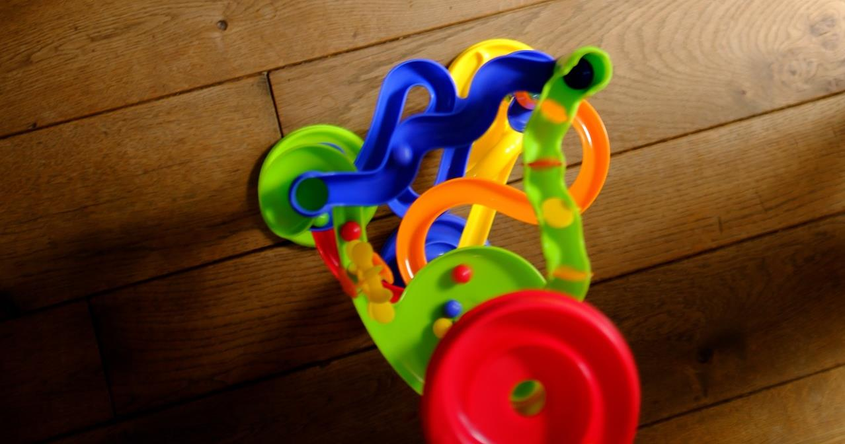
Notes:
Marble Run

Slide 4
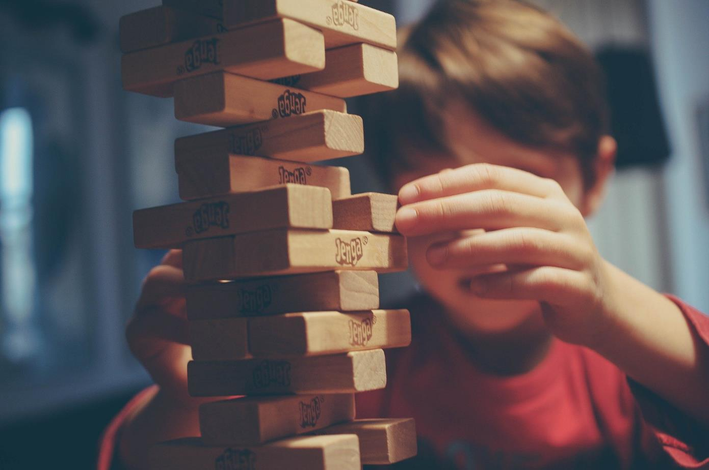
Notes:
Jenga

Slide 5
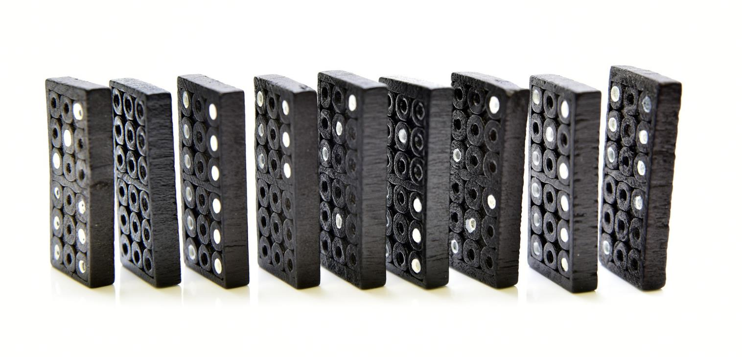
Notes:
Dominoes

Slide 6
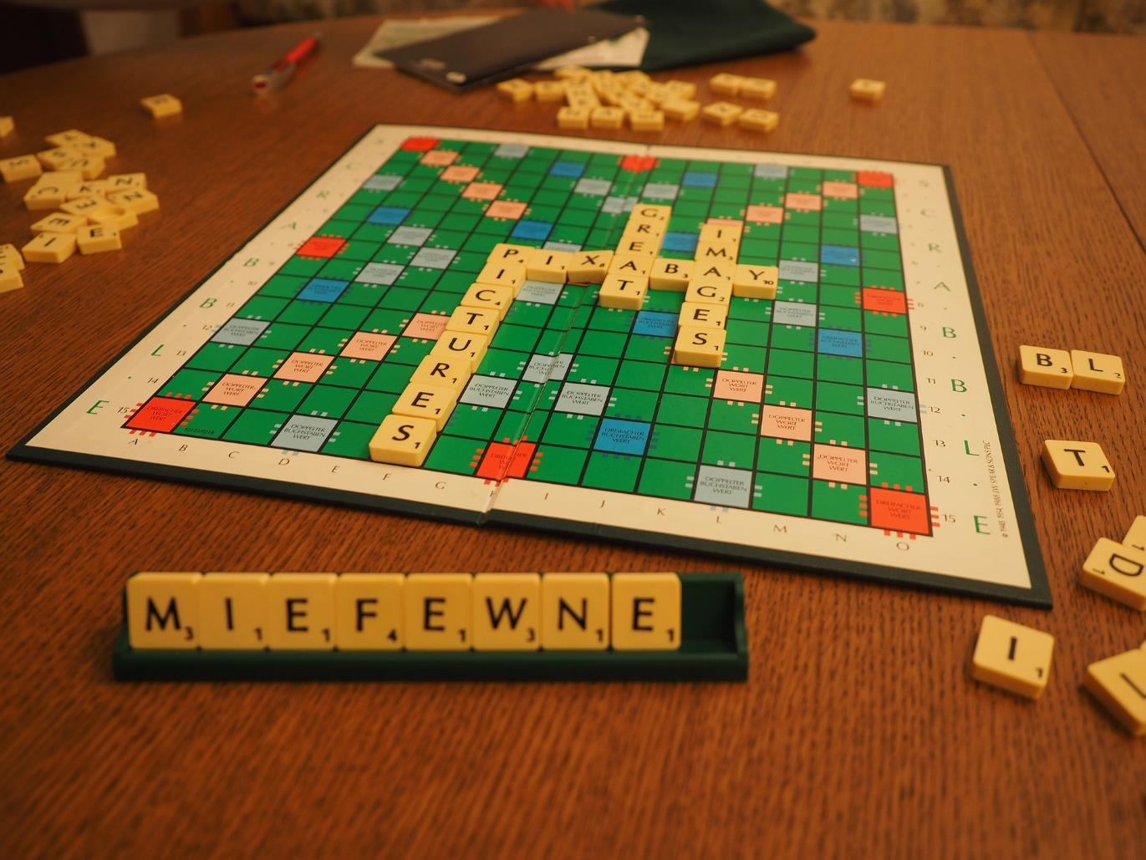
Notes:
Scrabble – word-building

Slide 7
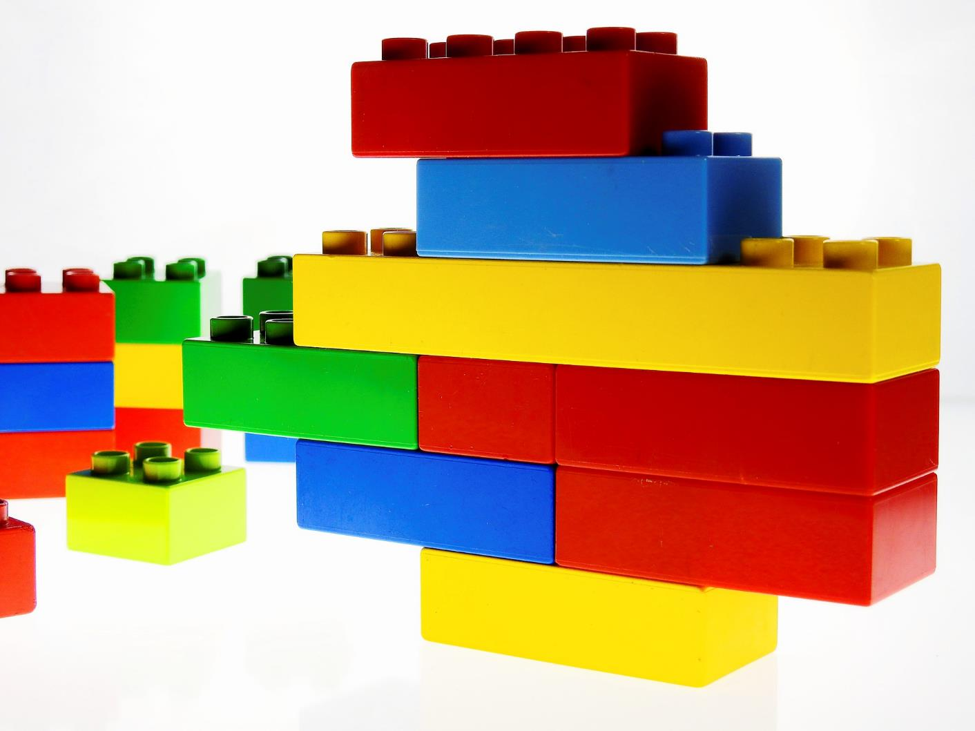
Notes:
Lego® or Duplo ®

Slide 8
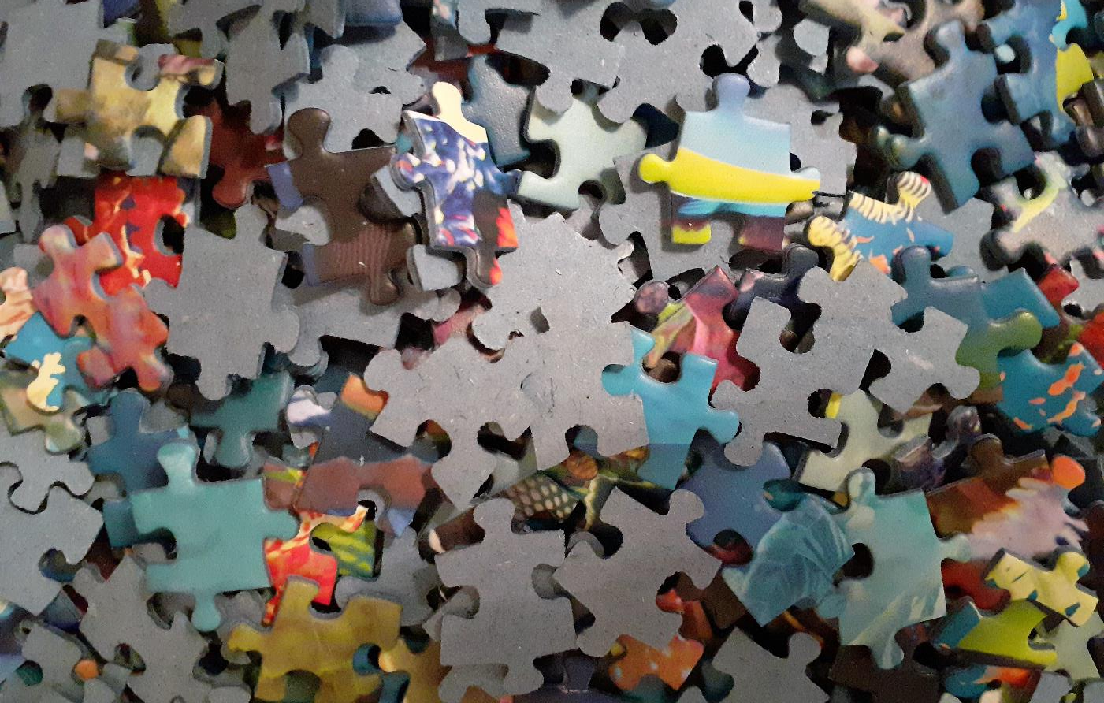
Notes:
Jigsaw puzzle

Slide 9
Jigsaws
Notes:
This artwork has been created especially for us for these assemblies!
Slides 9-12: Jigsaws Talk about the different images of the jigsaw puzzle – share ideas about how you ‘build’ a jigsaw puzzle, discuss especially where there are different opinions about how e.g. edges first / last, obvious picture sections, sometimes different puzzles mean that we have to find different ways of putting it together; lots of muddle before it gets sorted out!

Slide 10
Notes:
Slides 9-12: Jigsaws Talk about the different images of the jigsaw puzzle – share ideas about how you ‘build’ a jigsaw puzzle, discuss especially where there are different opinions about how e.g. edges first / last, obvious picture sections, sometimes different puzzles mean that we have to find different ways of putting it together; lots of muddle before it gets sorted out!

Slide 11
Notes:
Slides 9-12: Jigsaws Talk about the different images of the jigsaw puzzle – share ideas about how you ‘build’ a jigsaw puzzle, discuss especially where there are different opinions about how e.g. edges first

Slide 12
Notes:
Slides 9-12: Jigsaws different colours / pictures sorted together

Slide 13
‘Rebuilding Community’
Notes:
Slide 13: Our school community is a bit like a puzzle that we’re building in different sections. For now, we only have ……..classes in school, and how they are learning is a bit different from how it was before.

Slide 14
Nehemiah’s Big Rebuild
Notes:
Slide 14: Share the story of Nehemiah and the Big Rebuild as this will set the context for this set of resources to support your school as they return. It’s important to use this story, as it will be continued or referred to in subsequent weeks.
[Use story script here]
As with the people of God in the story, part of our school community is still not with us. Like the people, we are getting our school and our hearts ready for when we are all back together again.

Slide 15
Notes:
Slide 15: …We’ve been thinking today about the story of Nehemiah’s rebuild ….
…that he chose to hear God’s voice, and be courageous as he returned to Jerusalem….
…as he learned new skills….as he realised what a big job rebuilding was going to be….
….Nehemiah experienced many different emotions, many of which we are feeling at this time….
….rebuilding our school community is going to take time as well….

Slide 16
lugs
holes
Puzzle Prayers
Notes:
Slide 16: …look at your piece of the puzzle….
...it’s easy to think that one little piece doesn’t matter, but wherever it is, it is still a part of the puzzle...
….like the pieces of the puzzle, we are all a part of our school community, wherever we are…
We’re going to use our puzzle piece in the quietness now – you can choose whether you think, or whether you pray. [Point out ‘lugs’ and ‘holes’ so children can find them as you think together]
Look at the patterns or pictures on your puzzle piece: the piece of the puzzle that you hold is as unique as you: and each one of you matters, to our school community – and to God.
Now look at the ‘holes’ in your puzzle piece – the bits where the lugs fit: there are people missing from our school community, people we are missing. The puzzle will not be complete until we are all back at school – but children at home are thinking about you, just as you are thinking about them. Hold them in your heart – and pray for them in the silence….
Lastly, look at the ‘lugs’ on your puzzle piece – the bit that helps it to ‘fit in’ with other pieces: we are all going to have to learn how to ‘fit’ together again. We will need to be patient with each other and to be kind to each other. Think about what you can do to help everyone in your ‘class’ get along. Pray for them in the quietness…
God, Please help us to remember that we are all important in our school community, that we each matter. Help us to help each other ‘fit’ in.

Slide 17
Notes:
Amen

Slide 18
Keep your puzzle piece to remind you that you matter – and that we are all a part of the same school community.
Notes:
Slide 18: Leave children with the jigsaw piece as a reminder

